Slide 1
Panelist Comments: Measuring the New Economy
Robert J. Gordon
Virtual Conference, Luohan Academy
September 9, 2020

Slide 2
Pervasive Productivity Growth Slowdown: US and Europe
The slowdown in productivity growth in the advanced economies is pervasive since 2005
Can improvements in measurement explain part or all of the slowdown?
My study is limited to the U.S. and Western Europe, but Japan and developed East Asia have also experienced slowdowns

Slide 3
Four Intervals for US vs. EU-10, Early-to-Late Slowdown

Slide 4
Conclusions on EU-10 vs. U.S.
EU-10 productivity growth in 1972-95 similar to US 1950-72.
“Early-to-late’ slowdown is the same for total economy
Also the same for commodity sectors, quite similar for service sectors
Big difference is the 1995-2005 revival in the US but no revival in EU-10

Slide 5
Sources of Growth, MFP vs. Capital Deepening vs. Labor Comp.

Slide 6
Sources of Growth Summary
US: changing MFP growth explains almost all of the first three intervals, capital deepening steady
US: less capital deepening contributes along with MFP to the final slowdown
EU-10: steady slowdown is explained roughly equally by MFP and capital deepening
Labor composition contribution small but steady

Slide 7
Measurement Issues for U.S.
Upward bias in price indexes for computer hardware (insufficiently rapid rate of decline)
Nominal share of IT investment in GDP
1999-2000 2.8 2018-19 1.9
Thus with constant bias the mismeasurement of GDP and productivity have declined
Byrne et al show bias in labor productivity mismeasurement dropped from 0.4 in 1999-2000 to 0.2 in 2014-2015.
Bias in price inexes for semiconductor chips? It’s an intermediate good

Slide 8
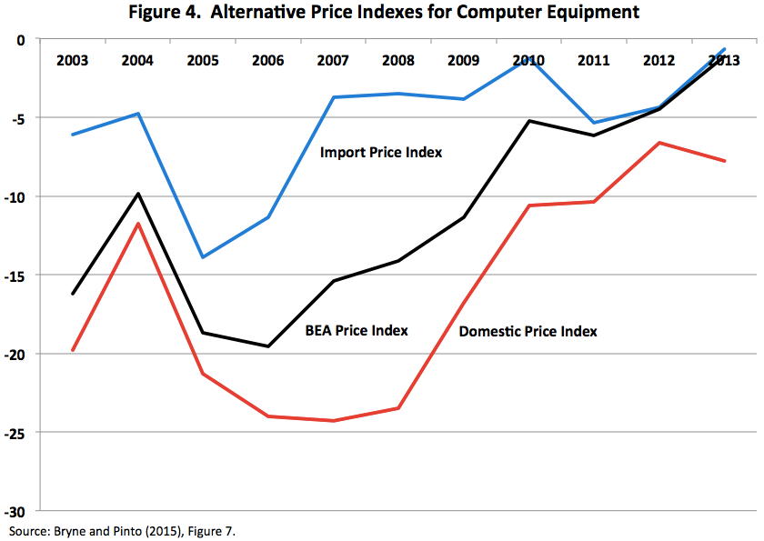
Three Price Indexes for Computers and Peripherals

Slide 9
Two Issues with Import Price Index for Computers
It must be wrong.
Imported computers are not getting steadily more expensive than domestically produced
If anything, reverse is true
Let’s say IPI is wrong
Replace import price index by GDP price index for computers.
No impact on GDP. More investment but more imports (which are subtracted out of GDP)
More capital deepening, slower growth TFP

Slide 10
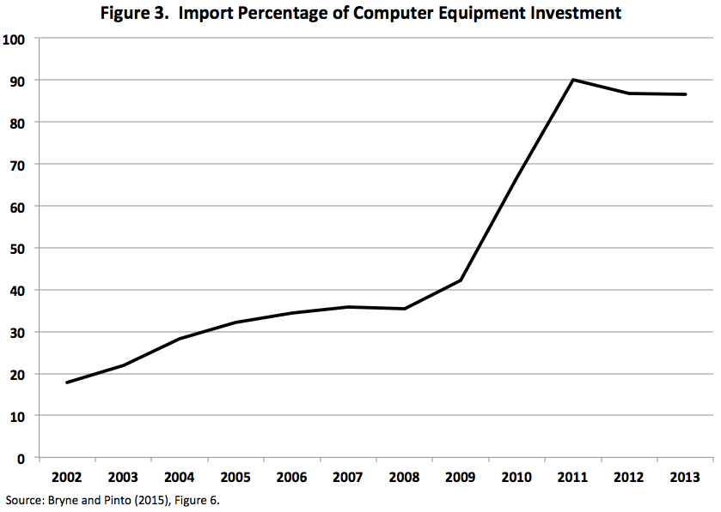
The Stunning Implications of the Import Takeover

Slide 11
Import Penetration in 2011-13 Equals 88%
To simplify, say it’s 100%
That means that computer output is no longer part of GDP
Any price index bias is irrelevant for GDP
But bias raises contribution of capital deepening to productivity growth
Thus reduces contribution of TFP to productivity growth

Slide 12
The Biggest Mismeasurement Issue: Free Internet Services
They’re not free. Both phone and internet subscription cost money
Some research measures value as wage times hours of free internet use
Should not multiply wage by time but rather compare the value of internet time vs. previous use of time
Radio, television, talking on the phone, playing board games

Slide 13
Further Considerations
Consumer surplus produced by smart phones and internet is much greater than increase in business productivity
Facebook use outside of production of business goods and services
Contribution of phone hardware is imported, not part of GDP.
CS not included in GDP is nothing new
Running water, indoor plumbing, removal of horse droppings, radio & TV, value of conquering infant mortality and infectious diseases

