Slide 1
Discussion of Bakker-Crafts-Woltjer “Sources of Growth . . . 1899-1941”
Robert J. Gordon
Northwestern University and NBER
Penn Economic History Forum
November 16, 2018

Slide 2
The Achievements of the Paper: Going Beyond Kendrick 57 Years Later
Extending the number of industries with TFP calculations
Improving labor quality contributions
Converting K to a capital-services basis
Extending endpoint from 1937 to 1941
Calculating intensive growth contributions at the level of 38 industries

Slide 3
Substantive Conclusions
Reducing 1899-1941 TFP growth from 1.7 to 1.3, primarily due to raising labor quality change from 0.3 to 0.8
1929-41 had the highest growth rate of 1899-1941 but lower than 1950s-1960s
Great Inventions contributed about 40% of TFP growth, not all
TFP growth not closely related to R&D inputs

Slide 4
What is the Big Question?
It is NOT whether TFP growth in the 1930s was faster than in the 1940s, 50s, or 60s
Rather it is about change in TFP growth over epochs, not decades
There is more agreement than disagreement that TFP growth was fast 1919-73, slow before and after

Slide 5
TFP Growth 1899-2015, BCW+BLS Table 4 vs. Gordon
TFP Growth, 1899-2015
Interval | BCW+BLS | Gordon
1899-1909 | 0.93 | 0.57
1909-1919 | 0.64 | 0.81
1919-1929 | 1.63 | 1.64
1929-1941 | 1.86 | 1.88
1941-1948 | 1.92 | 2.91
1948-1960 | 1.98 | 1.92
1960-1973 | 2.21 | 1.58
1973-1989 | 0.48 | 0.45
1989-2000 | 0.97 | 0.84
2000-2007 | 1.44 | 0.98
2007-2015 | 0.60 | 0.49

Slide 6
Looking at Epochs, Not Decades
TFP Growth, 1899-2015
Interval | BCW+BLS | Gordon
1899-1919 | 0.79 | 0.69
1919-1973 | 1.94 | 1.91
1973-2015 | 0.79 | 0.69

Slide 7
What Caused Super-charged TFP Growth in the Middle Epoch?
Everyone agrees that TFP growth 1919-73 was more than twice as fast as before or after
46 percent of the years between 1899-2015 accounted for 68 percent of the TFP growth
One way of asking the question: TFP growth at 0.7 to 0.8 percent appears to be “normal” so what caused TFP growth to be so much faster for a particular 50-year interval?
My suggestion: the “Great Inventions”

Slide 8
Interpreting the “Great Inventions”
No suggestion that they account for all TFP growth. Maximum: compare 1.9 1919-73 with 0.8 before & after, (1.9-0.8)/1.9 = 58% not 100%
For instance, rural-to-urban made a major contribution
Infrastructure – roads, bridges, airports
Should be counted as part of the incremental contribution of internal combustion engine
Always: incremental tinkering from mason jars to zippers to velcro

Slide 9
Authors’ Method of Computing Contribution of “Great Inventions”
They count TFP in 10 sectors as representing the “GI” contribution to growth
This accounts for 38% of growth 1899-1941
Problem:
Their method implies that there was no effect of the “GI” on the other 28 sectors out of 38
Farming omitted, yet ICE made possible consolidation into larger farms
FIRE omitted, yet electricity made possible subways & elevators, allowed consolidation into larger more efficient firms
Air conditioning in the 1930s raised service-sector TFP

Slide 10
Their Labor Quality Adjustment
0.8 points per year 1899-1941 implies a 40% rise in labor quality over 42 years.
This seems high in an age when high-school completion rose from 10 to 40%
I take Denison’s point seriously that earnings differentials overstate the contribution of education

Slide 11
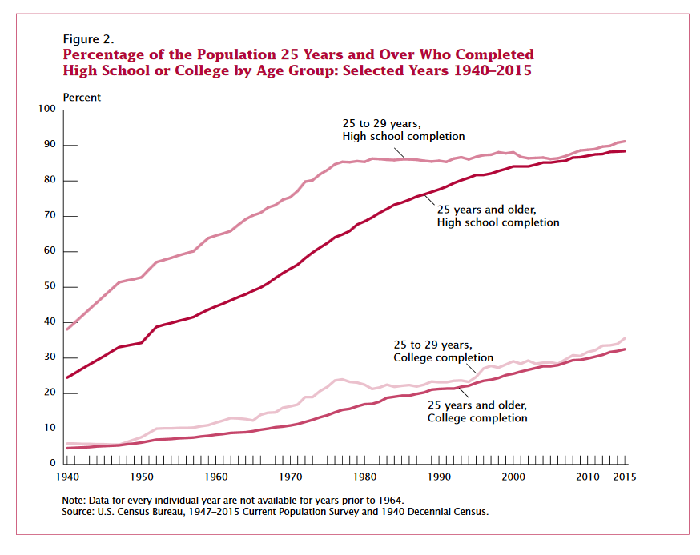
The Education Plateau

Slide 12
Non-comparability with Postwar BLS
Their estimate is 0.8 percent per year
Goldin-Katz 0.5 for 1915-40
BLS labor composition adjustment 1989-2015 is 0.40 per year
KLEMS is 0.32 1989-2015 and is only 0.23 1948-89
By overcounting labor quality change, authors reduce TFP growth pre-WWII compared to post-WWII

Slide 13
The Contentious Issue of a Cyclical Adjustment for 1941
Define the log ratio of actual to trend as the “gap” in output or labor productivity (LP)
The level of the LP gap is not a simple fraction of the level of the output gap
Instead the change in the LP gap reacts to the acceleration in the output gap
Consider a regression of the quarterly change of the LP gap on current and 4 lags of the change in the output gap

Slide 14
Current and 4 Lag Coefficients on Change in Output Gap, 1953-86

Slide 15
Level of LP and Output Gap, 1953-86

Slide 16
These Coefficients Can Be Used to Calculate the LP Gap Interwar
Relevance of postwar regression – LP is high relative to trend when output is growing rapidly as in 1941
Quarterly output gap data come from Gordon-Krenn
Multiply change in output gap 1919-41 by postwar coefficients
Cumulate predicted change in LP gap into a log level, setting 1928 = 100

Slide 17
Implied Ratio of Actual to Trend Labor Productivity, 1919-41

Slide 18
Annual Level of Actual and Trend Labor Productivity, 1929-41

Slide 19
Conclusion: 1929-41 LP Growth is Identical for Actual and Trend
Actual growth in LP = 2.60, trend = 2.58
No reason why the conclusion should be different for TFP growth
For 1941-48 using BEA chain-weighted GDP and Kendrick’s hours, Actual LP growth = 3.57, trend = 3.77
Unfortunately this paper did not extend its available data to cover the interval 1941-48

Slide 20
Last Topic: Relation of R&D Expenditures to TFP Growth
The authors take too literally the connection between measured, organized R&D expenditures and the sources of TFP growth
To take an extreme example, the rural-urban migration was a source of TFP growth but involved no R&D.
Did the ideas the enabled Henry Ford to create his assembly line at Highland Park in 1913 result from formal, measured R&D?

Slide 21
The Authors Take Seriously the Deeply Flawed Paradigm of N. Bloom
Bloom: Steady TFP growth and rising real expenditures on R&D prove declining R&D productivity
Consider an economy with no capital and constant productivity of research workers in creating new ideas:
Pop growth 1%, Real GDP/ pop = 4%
TFP growth = growth in stock of ideas = growth in research workers = 4%
Real wages increase 4%
Real expenditures on R&D = 4+4 = 8%

Slide 22
The Folly of Bloom-van Reenen: Productivity of Research Workers
An Economy With Fixed Ideas TFP
 | 0 | 1 | 2 | 3
1. Population (1%) | 100.0 | 101.0 | 102.0 | 103.0
2. Real GDP (5%) | 10000.0 | 10512.7 | 11051.7 | 11618.3
3. TFP (=GDP/Population) | 100.0 | 104.1 | 108.3 | 112.7
4. Stock of Ideas (=TFP) | 100.0 | 104.1 | 108.3 | 112.7
5. Change in Stock of Ideas | 3.9 | 4.1 | 4.2 | 4.4
6. Research Workers = Added Ideas | 3.9 | 4.1 | 4.2 | 4.4
7. Real Wage of Research Workers = TFP | 100.0 | 104.1 | 108.3 | 112.7
8. Real Expenditures on Research Workers | 392.0 | 424.8 | 460.1 | 498.5
9. TFP Growth | 4.0 | 4.0 | 4.0 | 4.0
10. Bloom - Van Reenen "TFP of Ideas" | 0.0102 | 0.0094 | 0.0087 | 0.0080
= TFP Growth / line (8)
11. Percent Growth Rate of "TFP of Ideas" |  | -8.0 | -8.0 | -8.0

Slide 23
Another Aspect of Productivity of Ideas
If there are 10 ideas, discovering one new one increases the stock of ideas by 10%
But if there are 100 ideas in existence, discovering one new one increases the stock by 1%
To keep up the old pace requires 10 times as many new ideas
Thus as the stock of existing ideas keeps growing exponentially, ever more resources must be devoted to discovering new ideas

Slide 24
Conclusions
This paper provides the first new industry-level data advance since Kendrick (1961).
Its very large labor quality adjustment numbers are much higher than in current BLS TFP calculations so bias down the pre-1941 growth of TFP. Either the BLS should be higher or BCW should be lower
Regarding the “Great Inventions,” no suggestion they should account for 100% of TFP growth. The issue is how much they contribute to EXTRA TFP growth 1920-70 compared to 1890-1920

Slide 25
More Conclusions
The endless debate about whether the “1930s are the most productive decade” is not worthy of the investment of the protagonists
Whether TFP growth 1929-41 was a bit smaller or larger than 1948-73 is NOT IMPORTANT
What is important is that so much progress was made in a decade when the economy was so depressed
And, for sure, no utilization adjustment for 1941 is warranted.

