Slide 1
Discussion of Glenn Hubbard’s “The $64,000 Question”

Slide 2
Strengths of Glenn’s Paper

Slide 3
Preview of My Reaction

Slide 4
The Stark Reality of Potential GDP Growth Since 2009

Slide 5
A Second Method: Output Growth Between Quarters w/ Identical U Rate

Slide 6
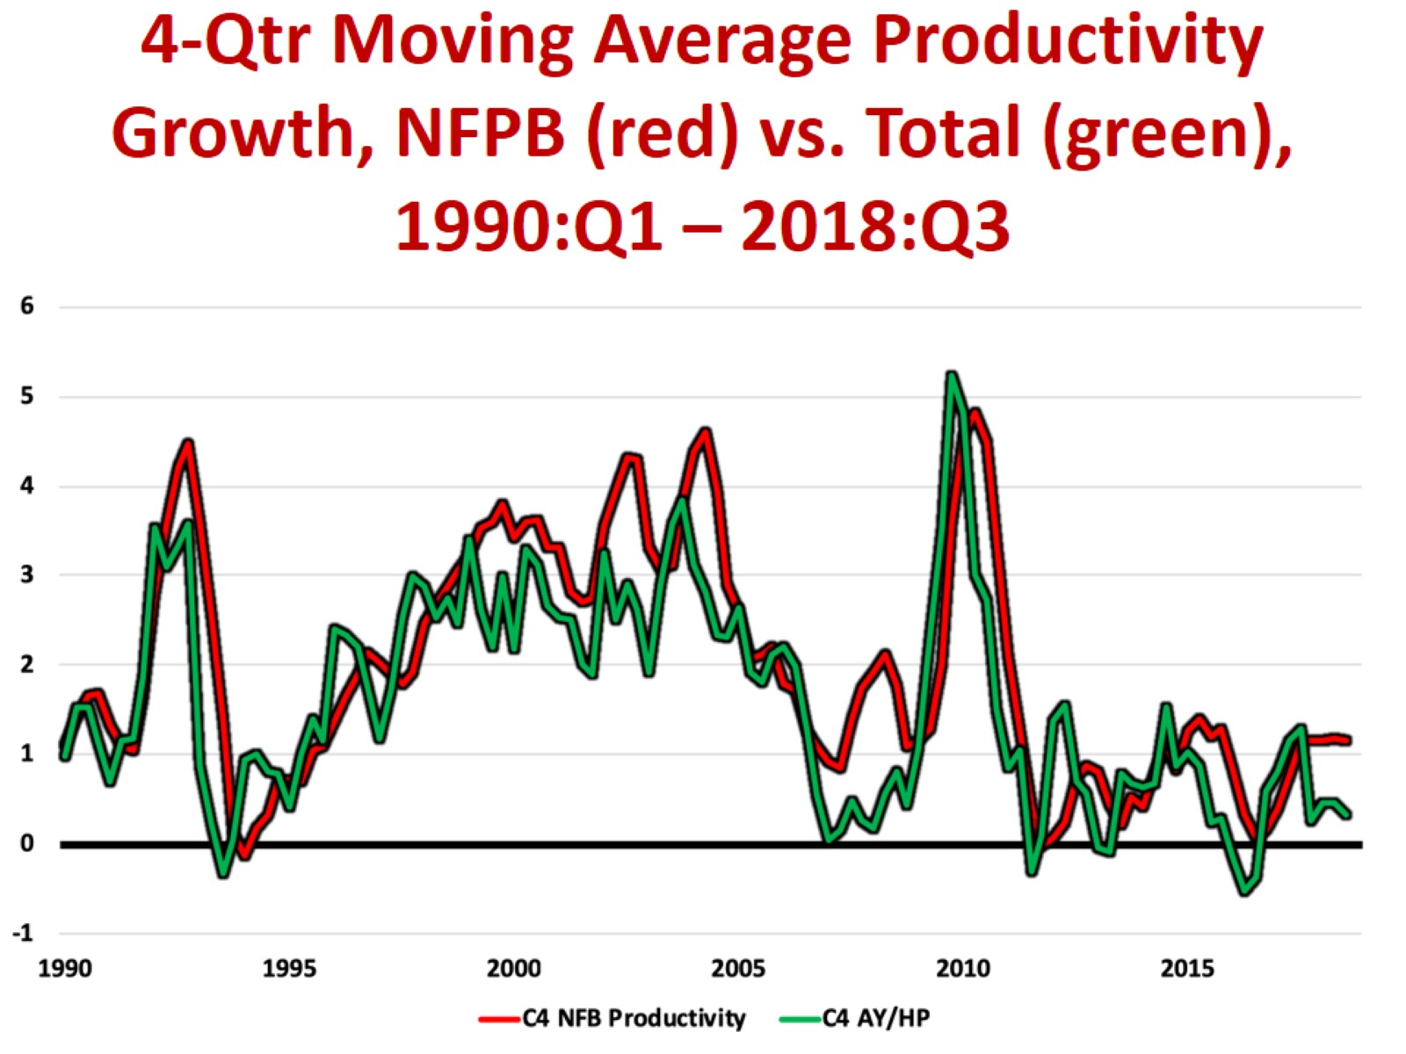
4-Qtr Moving Average Productivity Growth, NFPB (red) vs. Total (green), 1990:Q1 – 2018:Q3

Slide 7
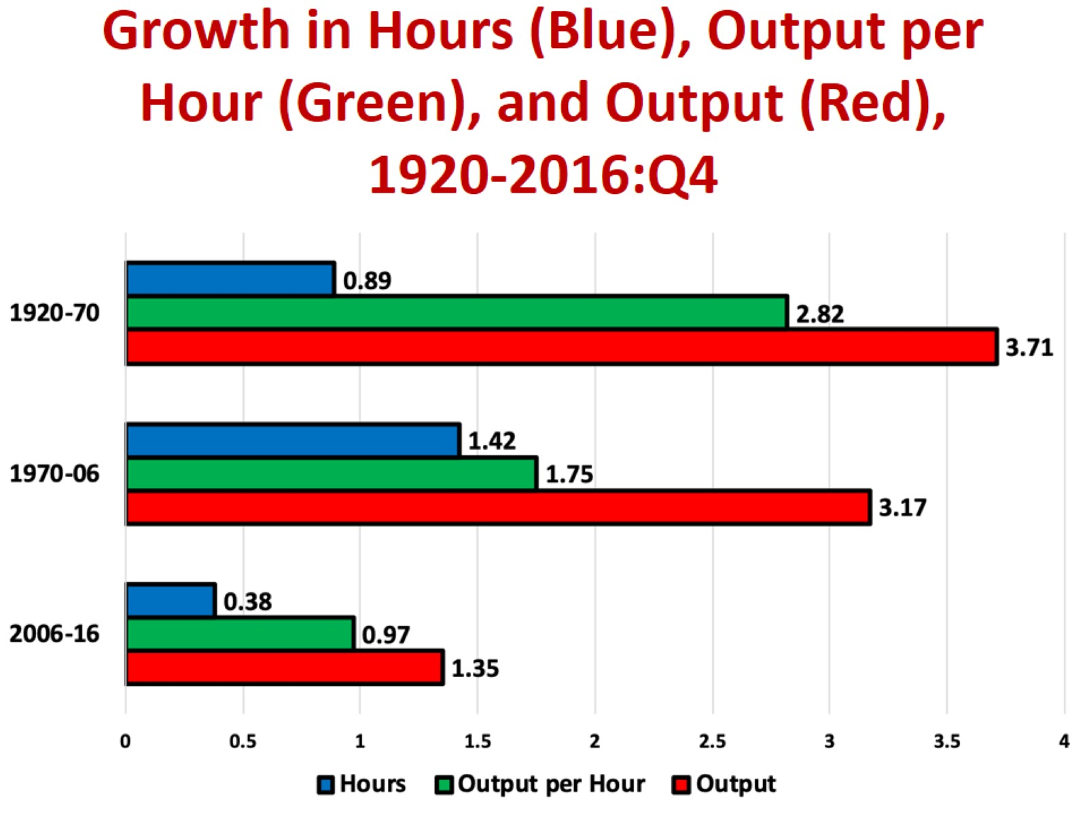
Growth in Hours (Blue), Output per Hour (Green), and Output (Red), 1920-2016:Q4

Slide 8
A Third and Better Method: The Kalman Filter

Slide 9
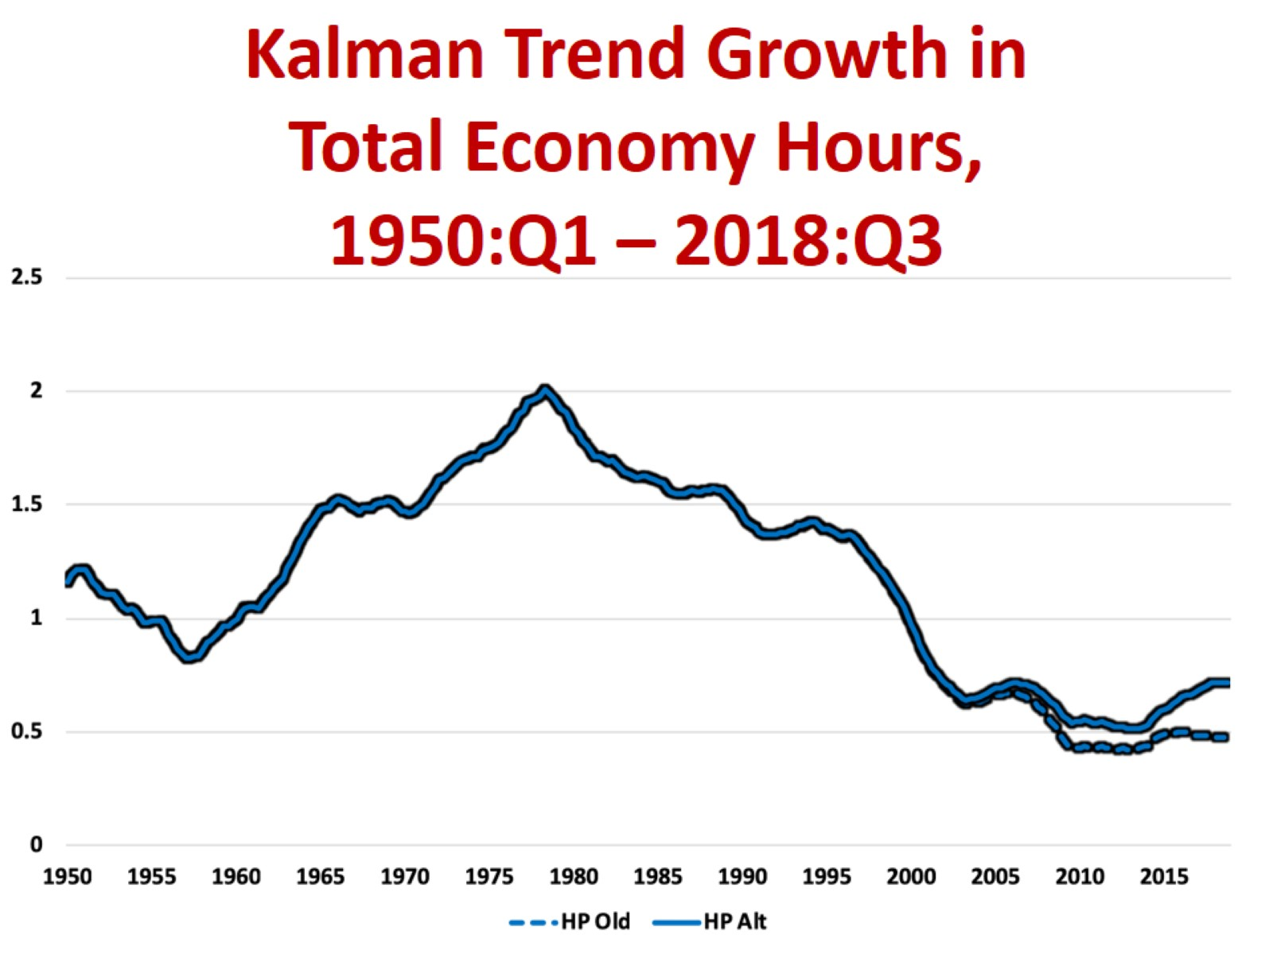
Kalman Trend Growth in Total Economy Hours, 1950:Q1 – 2018:Q3

Slide 10
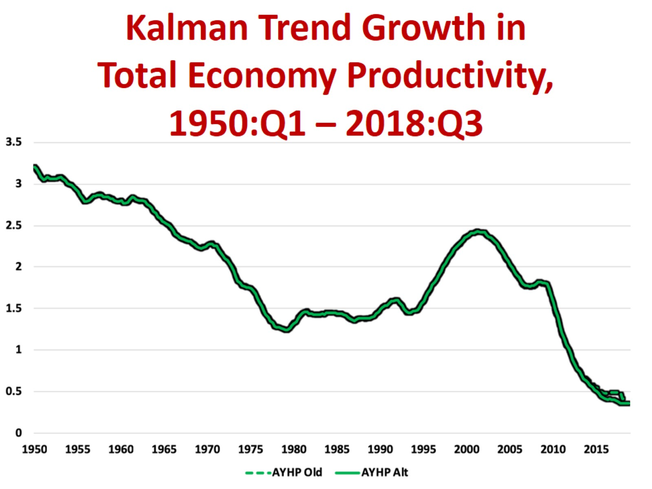
Kalman Trend Growth in Total Economy Productivity, 1950:Q1 – 2018:Q3

Slide 11
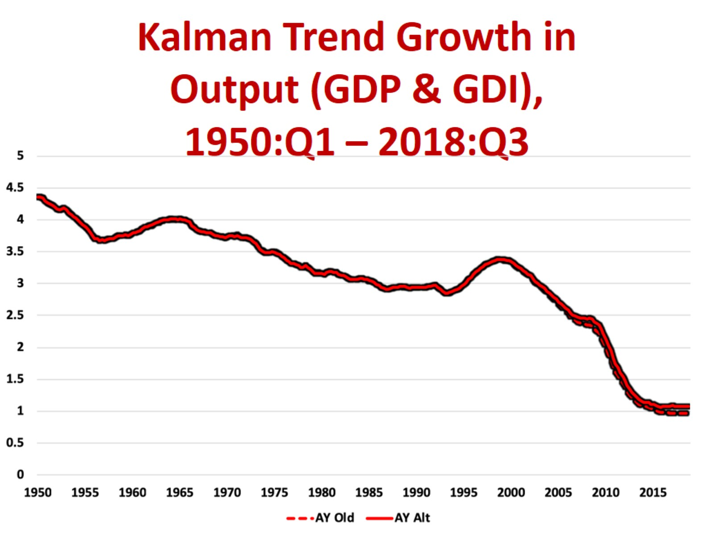
Kalman Trend Growth in Output (GDP & GDI), 1950:Q1 – 2018:Q3

Slide 12
Glenn’s View of a Feasible NFPB Productivity Growth Revival

Slide 13
The Techno-Pessmist’s Productivity Growth Revival

Slide 14
Techno-Optimists: 4th Industrial Revolution to Follow 3rd IR

Slide 15
Looking for the Payoff: 4th IR Innovation

Slide 16
Core of the 4th IR Case: Robots and AI

Slide 17
Do Robots Raise Productivity Growth in Manufacturing? US vs Germany vs. Japan

Slide 18
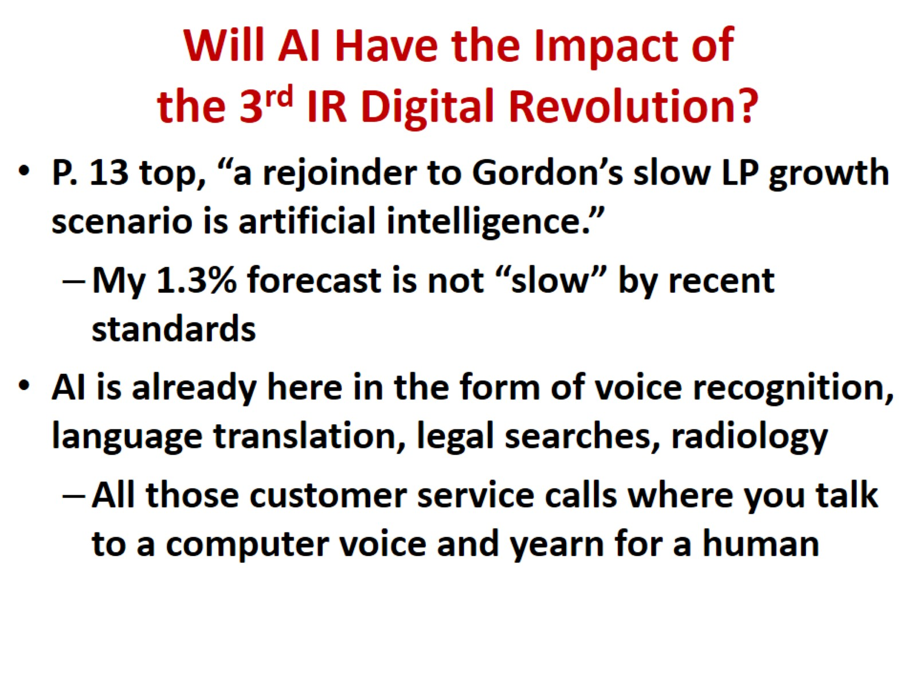
Will AI Have the Impact of the 3rd IR Digital Revolution?

Slide 19
AI Job Displacement Is Nothing New

Slide 20
ATM Machines and Bank Teller Jobs

Slide 21
Brick and Mortar Retail Job Losses versus e-Commerce Job Gains

Slide 22
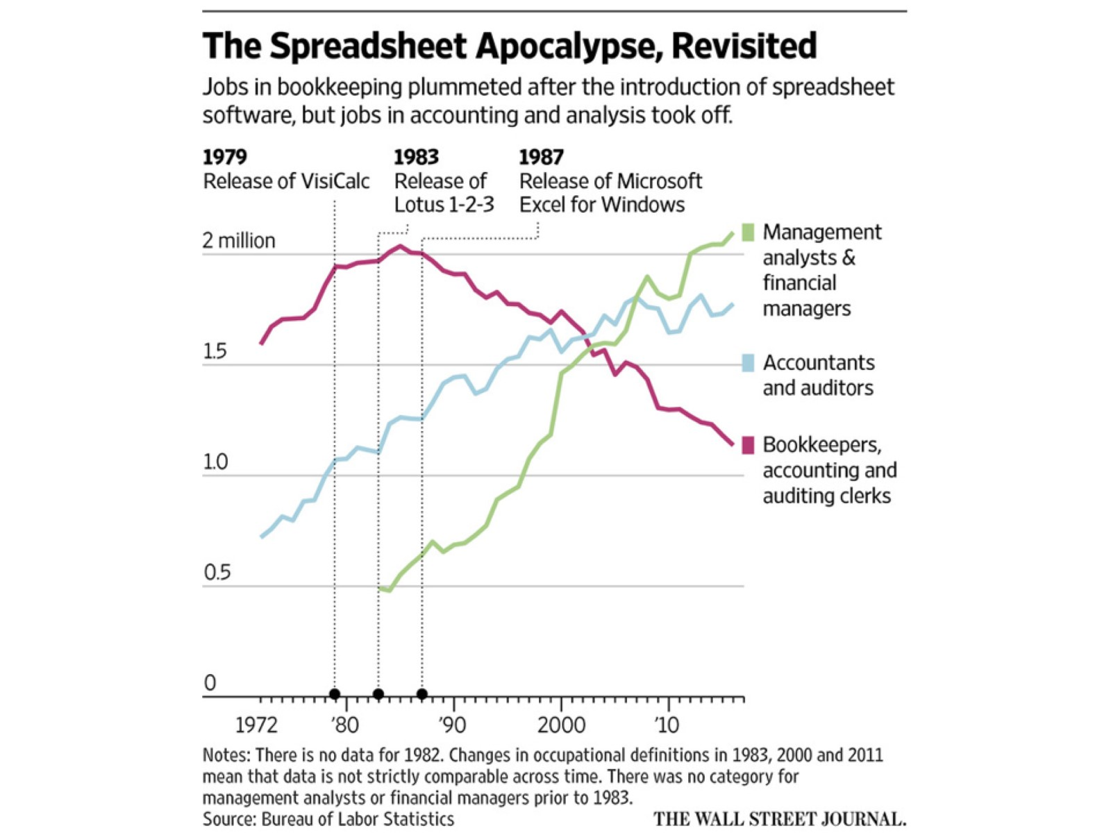

Slide 23
Glenn on Policy vs. My Book’s Policy List

Slide 24
Conclusions: Causes of Slower Output Growth

