Slide 1
Discussion of Kawaguchi on Robots and of Shinozaki on AI
Robert J. Gordon
Northwestern University and NBER
ESRI International Conference,
Tokyo, July 30, 2019

Slide 2
Background for the Discussion
Economic research on robots and AI is growing faster than their influence on the economy
Techno-optimists have predicted a 4th industrial revolution starting tomorrow as robots and AI replace human workers
No revolution, just a slow evolution
Most important fact about robots is their unimportance: IFR total 2017 worldwide investment in robots outside China: $11b
Nonres fixed investment in US $2,900b

Slide 3
Robots and AI Are Old News
First industrial robot installed by GM in 1961.
NBER group viewed U.S. auto factories in 1995 where robots were for welding and painting
Artificial intelligence (AI) is not new:
has already been replacing jobs for at least 20 years
predominant uses of big data analytics are in marketing, a zero-sum game
Evolutionary change: use of AI for voice recognition, language translation, radiology diagnosis, legal searches

Slide 4
Frey and Osborne (2013): Automation Destroys 47% of Jobs
Frey-Osborne 2013 is cited by both papers
Prediction: 47% of U.S. jobs will be replaced by “computerization” by 2033
In contrast U.S. economy has created 20m jobs since 2010. We’re 1/3 through F-O interval.
Their forecasts for computer replacement of jobs (they do this for 700 jobs):
Bank tellers (98%), restaurant cooks (96%), refuse collectors (93%), retail salespersons (92%), construction labor (88%), real estate sales agents (86%) ================airline pilots (55%)!

Slide 5
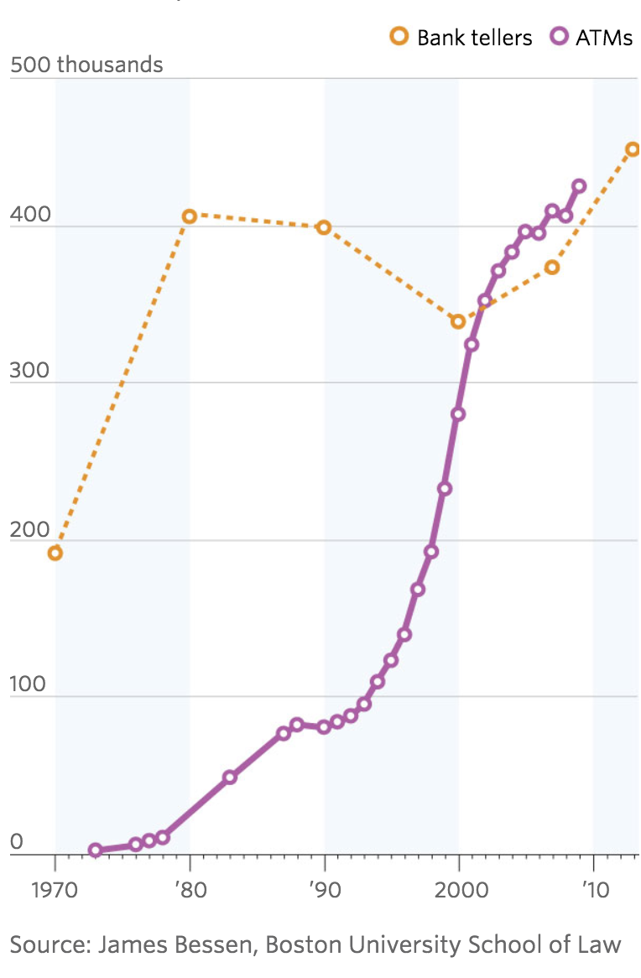
ATM Machines and Bank Teller Jobs

Slide 6
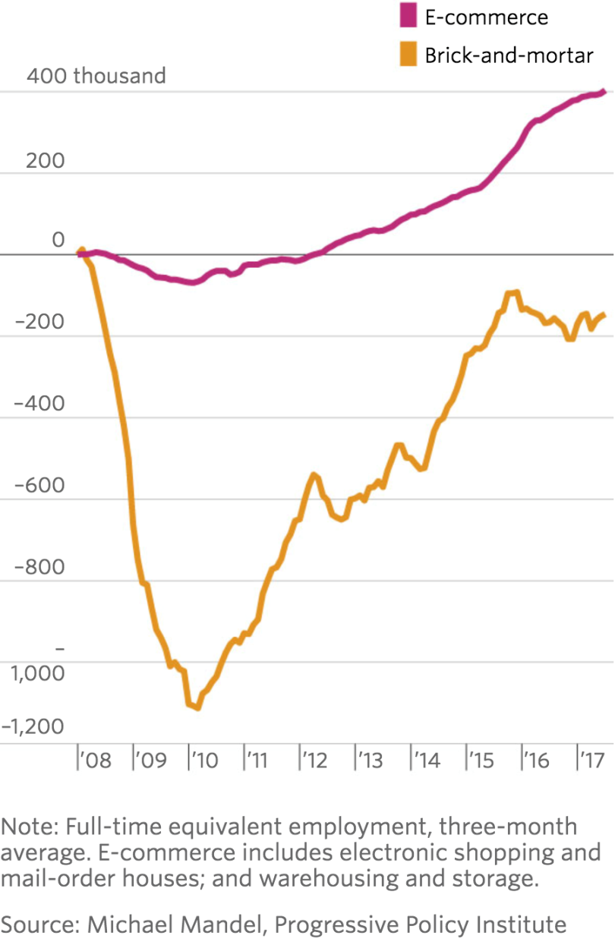
Brick and Mortar Retail Job Losses versus e-Commerce Job Gains

Slide 7
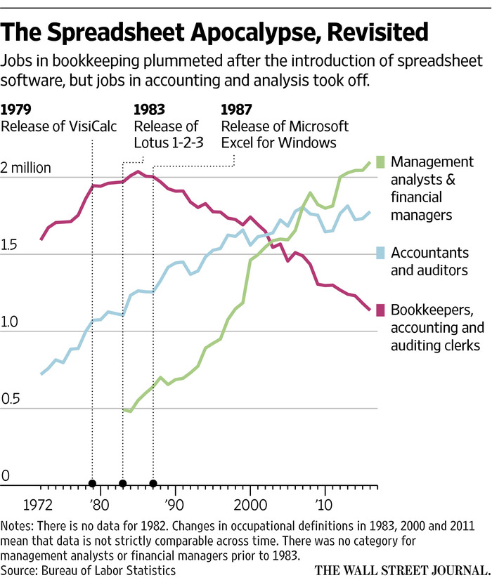

Slide 8
If Robots and AI Kill Jobs, They Must Raise Productivity Growth
We can indirectly examine the topic of today’s papers by looking at trends in productivity growth
We’ll look at productivity growth in
Total U.S. economy
U.S. manufacturing
Then robot penetration by country, contrast between South Korea and U.S.
South Korea should have accelerating manufacturing productivity growth, esp. relative to U.S.
Japan: manufacturing productivity growth compared to U.S.

Slide 9
U.S. Total Economy Productivity Growth, Kalman Trend, 1950-2018

Slide 10
Contrast Total Economy with Manufacturing, 1950-2018

Slide 11
Growth in U.S. Manufacturing Capacity, 1953-2019

Slide 12
Level of U.S. Manufacturing Capacity, 1948-2019

Slide 13
Level of Computer Capital Stock in US Manufacturing, 1987-2017

Slide 14
Robots per 10,000 Employees, Five Countries

Slide 15
Robot Ratio, U.S. vs. South Korea, 1993-2014

Slide 16
Manufacturing Productivity Growth, U.S. vs. S.K., 1955-2017

Slide 17
U.S. vs. Japan, 1955-2017 Average Growth Rate Identical, 1978-2017!

Slide 18
Do Robots Boost Productivity? Transport Equipment 1987-2017

Slide 19
The Kawaguchi Paper on Robots
Important contribution to make CZ the unit of observation
Detailed data on 300+ CZ’s – employment, population, age, sex, education, industry
A major achievement creating the data
The question is the effect of robots on these variables by CZ, but no data on robots in each CZ

Slide 20
Projecting CZ Robot Data from Industry Robot Data
2002-17 robot growth in a CZ is set equal to the industry share in that CZ times aggregate robot growth in that industry
Transport equipment has far more robot growth than any other industry
Endogeneity problem
Demand shock for an industry raises employment and robot growth
Solution: substitute German robot growth by industry as an IV

Slide 21
Surprising Results
Faster robot growth in a CZ raises employment, boosts population even more, thus reduces empl/pop ratio
Results overturn previous research
Frey-Osborne on job losses from automation
Acemoglu-Restrepo on 6 jobs lost per robot
Explanation for greater rise in population?
“Local multiplier effect”
“Gain in jobs in service sector”

Slide 22
Comments on Results
Very high correlation between Japan and Germany in industrial distribution of robots
Thus IV solution to endogeneity problem is unconvincing
Figure 6, empl/pop is almost uncorrelated with robots, regression line almost flat
Results depend on a few observations of CZ’s with high share of transport equipment
Figures 7 and 8, both empl and pop are positively correlated with robots. Why?

Slide 23
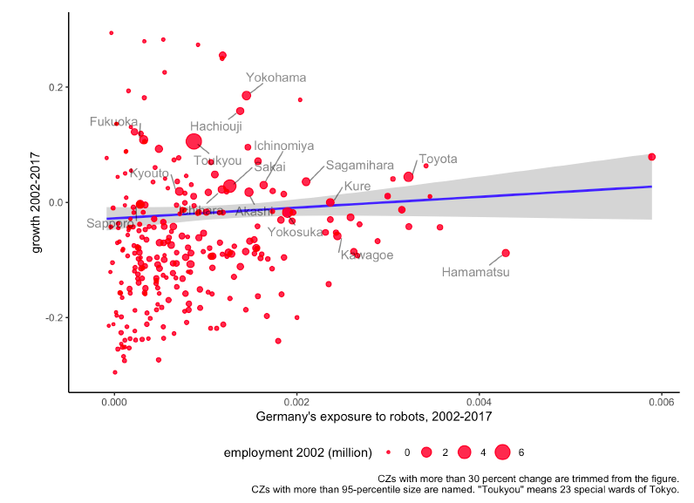
Reduced Form, Employment Rate

Slide 24
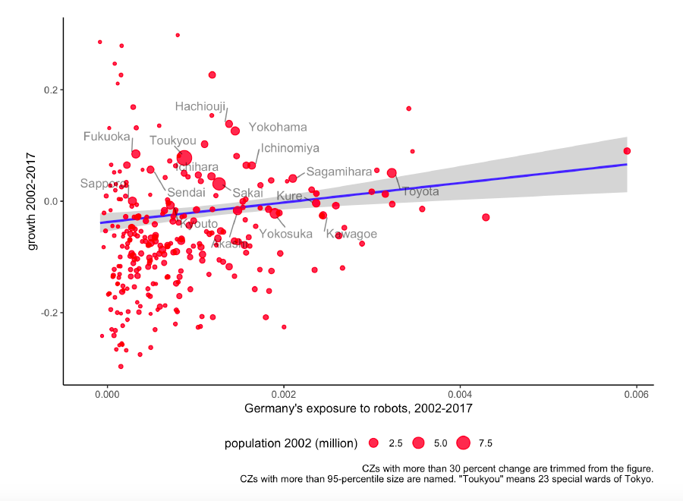
Reduced Form, Population Growth

Slide 25
Alternative Explanation
Robot variable (change per 1000 employees 2002-2017) very skewed.
Transport equipment +19
13 industries -3 to +0.3
Remaining 6 industries -12 to -4
So result that high robot change raises empl and pop amounts to saying
“CZ’s intensive in motor transport had above-average growth in empl and pop”
Many CZ’s dominated by other industries had population decline. The “Japan Rust Belt”

Slide 26
Shinozaki Paper on AI
Paper studies effects of AI on hours, employment, and three components of NRTI (reminds me of airport code NRT)
Results show very slight (4%) reduction in hours/employee in group “with AI” relative to group “without AI”
Surprisingly, AI – which would be expected to replace routine tasks – raised “repetition” task NRTI1

Slide 27
Measurement Issues
Unlike the robot paper, this paper does not use government or industry data
It is based on their survey of employees and managers
But results on hours/employee and task intensity are reported only for the employee survey
Primary emphasis on change in hours per employee reported by employees.

Slide 28
Measurement of AI, “Treatment” vs. “Control” Groups
The Kawaguchi robot paper found a spectrum of robot change intensity
This paper has no spectrum, either “AI Added Last 5 Years” or “No AI”
No consideration of a third category, “AI already present 5 years ago so no change”
No discussion of what qualifies as AI
Minority AI, 212 / 2266 observations

Slide 29
Difference-in-Difference Methodology
Treatment group is compared to control group
In robot paper we learned that firms with large robot change were different also because they made motor vehicles
Here there is no information on what kinds of firms are in AI group compared to no-AI group
They may be different in important ways related to employment growth

Slide 30
The Measurement of Hours
Employees are asked for change in hours compared to 5 years ago
This concept is hours/employee not aggregate hours. Do salaried employees work fixed hours
How can an employee remember how many hours worked 5 years ago?
Substitution from AI we’re concerned with total hours and employment, not hours/employee
Survey: only employees who remained.
Departing employees excluded, minimizes loss
New employees have no recall of past hours

Slide 31
Employee Survey vs. Manager Survey
Preferable to use manager survey
Can distinguish change in aggregate employment, hours/employee, and aggregate hours
Managers may have records of employee hours that employees cannot recall
Managers know how many employees have departed, total count of employees compared to five years ago
Note conflicting results, AI reduces hours/employee but increases employment

Slide 32
Task Intensity Measures
NRTI1 = repetition
NRTI2 = decision making
NRTI3 = communication
Can all tasks be accurately characterized by these three categories? What about other tasks?
Major part of paper is devoted to estimating AI effects on changes in hours by task.
Same question: Can employees remember 5 years ago?
Surprise! “repetition” task hours increased by AI, no significant AI effect on other tasks

Slide 33
Detailed Results by Five Occupational Categories
Significant reduction in hours/employee only for two of five occupations included
No results reported for employment
Significant increase in repetition NRTI1 for only two of five occupations included
Significant increase in decision making NRTI2 for only one of five occupations included
No significant effect for communication NRTI3 in any occupation

Slide 34
Authors’ Conclusions
Reduction in hours/employee and increase in employment reveals presence of both substitution and complementarity
This set of conflicting results can be questioned because of the defects in measuring hours/employee from an employee survey
Increase in “repetition” task
True for only 2/5 occupations
Even more severe memory problems of what tasks were performed 5 years ago
Future Research: survey managers not employees

