Slide 1
T Productivity Mismeasurement -- Discussion of Byrne, Fernald, and Reinsdorf
SubRobert J. Gordon Northwestern University and NBER
BPEA, March 10, 2016

Slide 2
An Excellent Paper of Comprehensive Scope
Convincing demonstration that measurement error for business sector productivity has declined since 2004
Less convincing that the value of free internet services can be written off as worth only a few basis points
Leaves open to the discussant to ask “why?”

Slide 3
Dimensions of the Productivity Growth Slowdown
Paper is framed pre-2004 and post-2004
Can’t decide in what is to be explained
Is it the post-2004 slowdown?
Is it the 1995-2004 revival?
In the end, “return to normal”
Too little emphasis on further split 2004-10 vs. 2010-15
242,000 new jobs? Oh, no!

Slide 4
Kalman Trend of Business Sector Output per Hour, 1955-2015

Slide 5
Dimensions of the Productivity Growth Slowdown
Growth Rates, business sector output / hour:
1948:Q1-1972:Q4 3.2
1972:Q4-1994:Q4 1.6
1994:Q4-2004:Q4 2.9
2004:Q4-2010:Q2 1.9
2010:Q2-2015:Q4 0.5
For mismeasurement to be the explanation, would have to explain 2.9 – 0.5 = 2.4
Alternatively, pre/post 2004 2.9 – 1.2 = 1.7

Slide 6
Two Interpretations
Jan Hatzius and Kris Dawsey, it’s all a measurement illusion
Their conclusion implies bias worse by 2.4
Boskin Commission upward bias 1.1
My contrary interpretation supports the paper: the slowdown is real. Measurement has been getting better for market goods & services

Slide 7
Computer Prices
Matter for GDP deflator and hence real GDP, thus labor productivity
Table 1 Comparing BEA with Alt – “liberal”
1994-2004. -5.1
2004-2014. -4.5

Slide 8
Shrinking Investment Share Causes Constant Bias to Reduce Mismeasurement
Nominal share of IT investment in GDP
1999-2000 2.8 2014-15 1.8
Thus with constant bias the mismeasurement of GDP and productivity have declined
Table 2, labor productivity mismeasurement from 0.4 to 0.2
Table 2, TFP mismeasurement from 0.04 to
-0.08

Slide 9
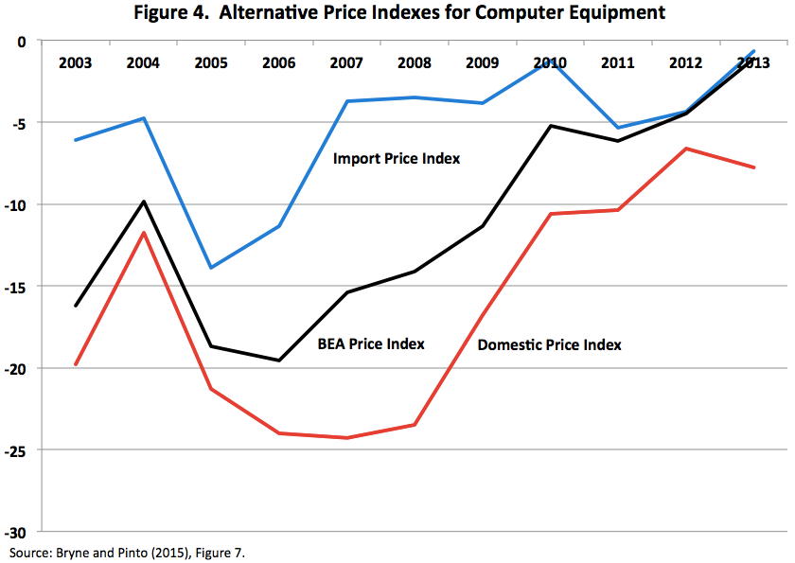
Three Price Indexes for Computers and Peripherals

Slide 10
Two Issues with Import Price Index for Computers
It must be wrong.
Imported computers are not getting steadily more expensive than domestically produced
If anything, reverse is true
Let’s say IPI is wrong
IPI = PPI implies BEA = PPI.
No impact on GDP. More investment but more imports
More capital deepening, slower growth TFP

Slide 11
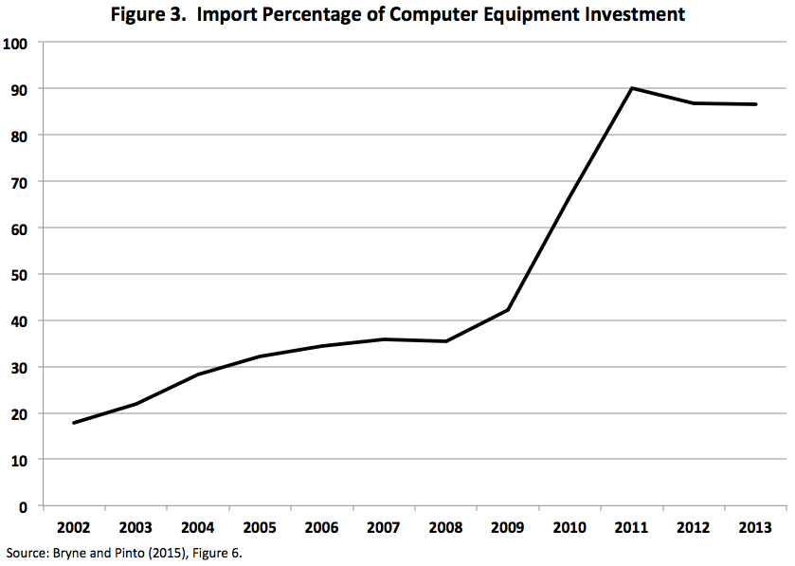
The Stunning Implications of the Import Takeover

Slide 12
Import Penetration in 2011-13 Equals 88%
To simplify, say it’s 100%
That means that computer output is no longer part of GDP
Any price index bias is irrelevant for GDP
But bias raises contribution of capital deepening to productivity growth
Thus reduces contribution of TFP to productivity growth

Slide 13
The Biggest Mismeasurement Issue: Free Internet Services
Hatzius-Dawsey copy 0.75% from Brynjolfsson-Oh 2012
Measured by multiplying wage by hours of use
Problems
Should compare 2004-14 with 1994-2004
Should not multiply wage by time but rather the value of internet time vs. previous use of time
Diminishing marginal utility of leisure
CS value? More like 0.2 to 0.3, not 0.75

Slide 14
Further Considerations
Authors reject such an adjustment for consumer surplus “if the question is the productivity of the economy in producing market goods and services”
Authors too reluctant to recognize the value of the CS of facebook, instagram
CS not included in GDP is nothing new
Running water, removal of horse droppings, radio & TV, value of conquering infant mortality

Slide 15
Why the Slowdown?
The digital revolution transformed office work between 1980 and 2005, little change since 2005
Pre-internet 1980-95: PCs, word processing and spreadsheet software, electronic catalogs, telephone menus, ATMs, bar-code scanning
Internet 1995-2005: free information, search engines, e-commerce, airport check-in kiosks
It was all there by 2005

Slide 16
Stasis Since 2005
Stasis in
Office procedures and methods across all industries
Retailing, restaurants
medical care with its cost inflation
education, with its cost inflation in administrative overhead unrelated to instruction
Symptoms of low-impact of innovation: declining business dynamism, share buy-backs in preference to net business fixed investment

Slide 17
Conclusion
Extent of mismeasurement was greatest when ICT investment was highest, late 1990s.
Measurement has improved, opposite of getting worse, for business productivity
Paper needs more work on consumer surplus from smart phones – need to consider alternative uses of time.
Partly a shift of activities from desktops, laptops, and TV sets to phones.
But also partly net addition to leisure time as utility-raising activities take the place of previously idle time

