Slide 1
Potential Output: Its Recent Behavior and Future Growth
Robert J. Gordon
Northwestern University and NBER
WEAI Annual Meeting
San Francisco, July 1, 2019

Slide 2
The Great Debate About Future Growth
How Fast Will Potential Real GDP Grow Over the Next Decade?
The CBO predicts 1.9% p.a. 2018-2028
The Fed has endorsed the same 1.9% as recently as its projections of June 19
But the Administration and the ERP forecast 3.0% growth forever
Both can’t be right, but maybe both wrong
The outcome matters for future standard of living, debt/GDP ratio

Slide 3
The Questions for Today
How Fast Has Potential Output Grown Since 2007? More Recently Since 2014?
How Fast Will Potential Output Grow?
Puzzle #1, Future Labor Force Participation
Puzzle #2, Future Productivity Growth
To Forecast Productivity Growth, We Have to Determine Why It Has Been So Slow
Which Explanations Are Convincing? What Do They Imply for the Future?

Slide 4
Measuring Potential Output
Every Reference Here to Output is to the AVERAGE of GDP and GDI
Output is at Potential when Unemployment is at the NAIRU, defined as a condition of stable inflation
The output gap is zero when the unemployment gap is zero
So measuring potential output starts with the NAIRU

Slide 5
The CBO Long-run NAIRU, 1948-2018, Adjusted Down for 2007-2018

Slide 6
Take End-of-Expansion Quarters with Zero Gap and Connect Them

Slide 7
Alternative to Stepwise Series, Preferable to Use Kalman Filter

Slide 8
For All Business Cycles Since 1960, Both Methods Give Same Answer

Slide 9
The Output Gap? Both Methods Provide the Same Answer

Slide 10
Output Trend Divided between Trends in Productivity and Hours

Slide 11
Decomposing Potential Output Growth
Output Growth Equals Productivity Growth plus Hours Growth
Hours Growth Consists of
Hours per Employee
Employment Rate (Zero for Potential Output)
Labor Force Participation Rate
Population Growth
CBO to 2028: 0.5 Hours, 1.4 Productivity

Slide 12
The Anatomy of Output Growth, 2007-2018 and 2014-2018

Slide 13
How Baby-boom Retirement Has Changed the LFPR, 1990-2026

Slide 14
My Optimistic Adjustments to BLS Projections
Four age groups (16-24, 25-54, 55-64, 65+)
My adjustments
End of declining LFPR for 16-24
Continued recovery of 25-54 halfway back from now to 2000 peak
Result?
BLS 2019-2026 -0.48 percent
My alternative -0.16 percent

Slide 15
Implications for Potential Output
CBO has 0.5% hours and 1.4% productivity growth.
Their 0.5% hours growth combines 0.9% population growth and -0.4% LFPR change
My alternative, 0.75% hours growth with the same 0.9 % population growth and -0.15% LFPR change
Ignores any change in hours / employee, since there was zero change 2007-2018
And by definition of potential output, zero change is assumed for the employment rate

Slide 16
The Big Puzzle: Productivity Growth
Actual data, not trend estimate: Total economy 0.48% 2010:Q4 – 2017:Q4
Which Hypotheses are Convincing?
Will Investment Come to the Rescue?
Interpretation of 2018 Revival: Just procyclical or a revival of trend?
Prospects for a turnaround of innovation

Slide 17
Assessing Alternative Explanations of Slow Productivity Growth 2011-17
To be convincing, an explanation must explain why productivity growth was fast 1995-2004, slow after 2010
Explanations relying on gradual change cannot explain this timing – e.g., rising concentration
To be convincing, an explanation must explain why slowdown was worldwide among developed countries
A US-centric explanation like increased regulation under Obama doesn’t explain others

Slide 18
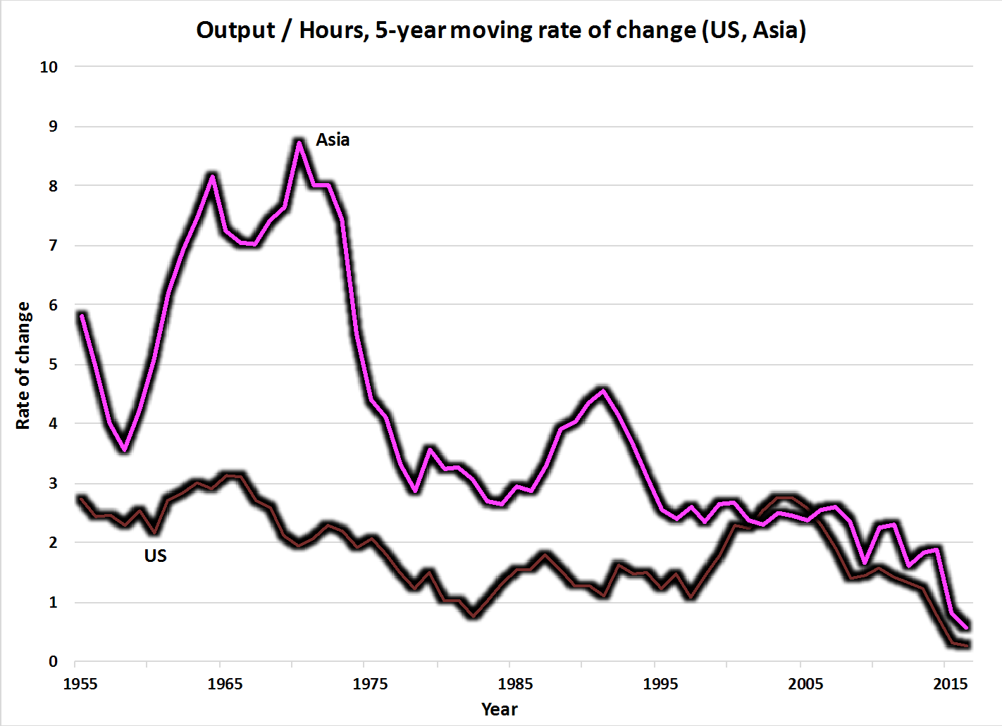
Productivity Growth, US vs Developed East Asia, 1955-2017

Slide 19
Productivity Growth, US vs. W. Europe (EU-15), 1955-2017

Slide 20
The Leading Hypothesis: Diminished Impact of Innovation
U.S. Productivity Growth nearly 3% for five straight decades, 1920-1970, then slowdown to 1.3%. Influence of “Great Inventions”
Digital revolution boosted growth back to 3% for only 8 years, 1996-2004
By 2005 the transformation of office work from paper, typewriters, and file cabinets to flat screens and the internet had been completed
The retail revolution based on big box stores, bar-code scanning, and computerized inventory management was largely finished

Slide 21
Has Innovation Declined Since 2005? No, But Lower Impact on Business
Diminished Impact of Innovation
The past decade: smartphones and tablets
Large unmeasured reductions in costs of photography, communication, information
Changed consumers lives without changing business methods of production
Phones are imported, which limits the effect of price index bias on GDP
Import share of IT equipment has increased from 30% in late 1990s to 90% now

Slide 22
Bloom et al.: Ideas Are More Costly to Find
Moore’s Law, computer chips, research productivity has fallen by a factor of 18 since 1971
Research productivity in agriculture has declined by 4 to 6% per year since 1960
Research productivity in curing diseases has declined by between 5 and 10% per year since 1970
“It takes 15 times more researchers as 30 years ago to produce same rate of firm revenue growth”

Slide 23
Slower Growth of Educational Attainment
Timing and Across Countries
Higher educational attainment raises labor quality, a contribution to productivity growth
From 1900 to 2005, increased labor quality boosted productivity by 0.3-0.4% annually
Since 2012, closer to 0.0-0.1%
End of improvement in HS completion
Slower rise of college completion
40% of college graduates can’t find jobs requiring a college education

Slide 24
Concentration and Business Dynamism
Rising Concentration
Record high profit share, high markups
Top 1% firms share of patents 35 to 50%
Less pressure on top firms to compete by raising productivity
Declining Business Dynamism
Falling share of business startups
Declining contribution of reallocation to growth
Problem: these changes are gradual trends and don’t account for the 1996-2004 revival

Slide 25
The Measurement Explanation
Everyone agrees price index bias forever, but it was roughly constant over decades
Didn’t disappear 1996-2004, then balloon after 2004
Consensus View
Byrne, Fernald, Reinsdorf (2016)
Syverson (2017)
For GDP (as contrasted to consumer welfare)
End of Moore’s Law, slower price decline
Smaller share of domestic IT manufacture
Upward biased import price indexes mean greater growth in real imports

Slide 26
Other Unconvincing Explanations
Burdensome regulations
Requires shift from no regs 1996-2004 to burdensome regulations 2011-17
Not that much contrast Clinton vs. Obama
Occupational licensing and land-use regulations at state and local level
High taxes replaced by Trump tax cuts
Clinton raised taxes in 1997 yet economy achieved its dot.com investment and productivity boom
Corporate reaction to Trump tax cuts has been largely to raise dividends and stock buybacks, little response so far of investment

Slide 27
Future Potential Growth Depends on Productivity Growth
Range of possibilities for total economy
2011-2017 0.48%
Kalman trend 2018:Q4 0.61%
CBO projection 1.4%
Reasons for outcome above 2011-17
2018 outcome 4-qtr average 0.9%
Possible investment boom
Future influence of AI, robots, autonomous vehicles
Productivity trend has unexplained ups and downs, adjustment lags

Slide 28
Interpreting the Revival in 2018
Productivity growth rose from 2011-17 0.5% to 0.9% in 4 quarters ending 2018:Q4
Two classes of explanations
Increased gap due to procyclical response to faster demand growth
Faster trend
Determine mix of the two via regression of gaps
Regression indicates normal procyclical response explains all but 0.1% of 2018 rise
Resulting error implies trend increased 0.6 to 0.7%

Slide 29
Role of Investment
Productivity growth equals TFP growth plus contribution of capital deepening
More of slowdown associated with TFP than with investment (business sector not total economy)
1996-2004 2011-2017 Diff
Productivity 3.3 0.7 2.6
TFP 1.8 0.3 1.5 Cap deepening 1.5 0.4 1.1
It would take a return of investment to late 1990s levels to boost productivity growth by 1%

Slide 30
GDP Growth and Contribution of Fixed Nonresidential Investment, 1990-2019

Slide 31
Net Business Investment as a Share of Capital Stock, 1950-2018

Slide 32
Growth of Capital Services, 1948-2023

Slide 33
Prospective Return of Investment to Late 1990s?
Macro Advisers (charts) shows investment to decline from 2019 peak
Monopoly power explanation of low investment, if true, won’t turn around
Shift of economy toward low capital-intensive services, declining price of capital goods, won’t turn around
Corporate tax cuts? Evidence so far of dividends and share buybacks, not increased investment
Productivity growth and investment are co-determined, lagging innovation impact holds down investment

Slide 34
Future Revival Created by Robots, AI, and Autonomous Vehicles
Growing use of robots didn’t prevent precipitous decline in manufacturing productivity trend
AI influence isn’t suddenly jumping from no role to significant role
AI role long embedded in automated customer service phone responses
AI already exists: voice recognition, language translation, legal searches, robo financial services
Autonomous vehicles still aren’t ready for driverless use
Long, gradual replacement of existing 275m vehicles

Slide 36
The Future Growth of U.S. Total-economy Productivity
Total economy productivity slower than private business sector (2018 0.9 vs. 1.4)
Regression analysis suggests 2018 pulled trend up only from 0.6 to 0.7
Brynjolfsson, Syverson delay argument
40 years for electricity to matter in mfg, 1880-1920
40 years for computer age to blossom 1996-2004
We’re still waiting for the impact of AI and robots
No correlation of productivity growth between decades

Slide 37
Conclusion: Future Growth in Potential Output
Brynjolfsson, Syverson push me to raise productivity trend from 0.7 to 1.2
But compelling evidence of a decline in the growth of labor quality (educational attainment) pushes back from 1.2 to 1.0
Add future growth of hours: 0.75% in contrast to other forecasts of 0.5%
Total for potential output, 1.0 + 0.75 = 1.75
Contrast to CBO, 1.4 + 0.5 1.9
So, we arrive at a similar conclusion by a different route

