Slide 1
The Rise and Fall of American Growth
Robert J. Gordon
Northwestern University and NBER
International Monetary Fund – Open Forum
July 7, 2016

Slide 2
Secular Stagnation: The Perspective in 2016
Actual real GDP growth:
1974-2004 3.12 2004-15 1.56
Slowing potential GDP growth
Potential Output per Hour
Potential Hours of Work
Working-age Population
Falling Labor-force Participation Rate (LFPR) reduces Hours per capita

Slide 3
Preview: Primary Source of Secular Stagnation is Slowing Productivity Growth
The best organizing principle to think about innovation is to distinguish among the industrial revolutions (IR #1, IR #2, IR #3).
The 1st IR occurred 1770-1840, continued impact through 1900
Steam engine, railroad, steamships
Cotton spinning and weaving
Transition from wood to steel

Slide 4
The 2nd IR occurred 1870-1920, continued impact through 1970
Electricity, light, elevators, machines, air conditioning
Internal combustion engine, vehicles, air transport
Telephone, phonograph, movies, radio, TV
Running water, sewer pipes, and the conquest of infant mortality
Chemicals, plastics, antibiotics, modern medicine
Utter change in working conditions, job & home

Slide 5
Why Did Productivity Grow Faster In the Century Before 1970? The One-Time-Only Inventions
Polluting flames for light >> instant on-off electric light
Factory power with steam engines and belts >> electric machine tools and hand tools
Offices and home cold and hot >> central heating and air-conditioning
Horses >> motor vehicles and air travel
Mainly rural 1870 >> mainly urban 1950

Slide 6
Retrospectives on the Revolutionary Century, 1870-1970
Looking Back at 1867 from 1927
Most of the progress had been made by 1940
Looking Ahead to 2000 from 1939
Looking Ahead to 1939 from 1878

Slide 7
Third Industrial Revolution
Since 1960 the “EICT” Revolution
Entertainment: the evolution of TV from color to time-shifting and streaming
Information Tech – the evolution from mainframes to PCs, the web, and e-commerce
Communications: mobile phones, smart phones
Productivity enhancers: ATM, bar-code scanning, fast credit card authorization

Slide 8
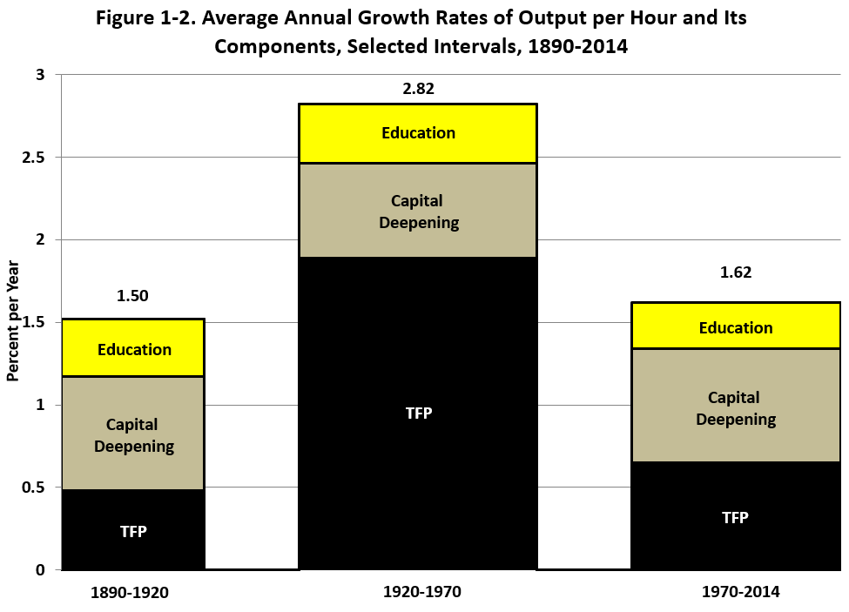
The Three Eras of Productivity Growth

Slide 9
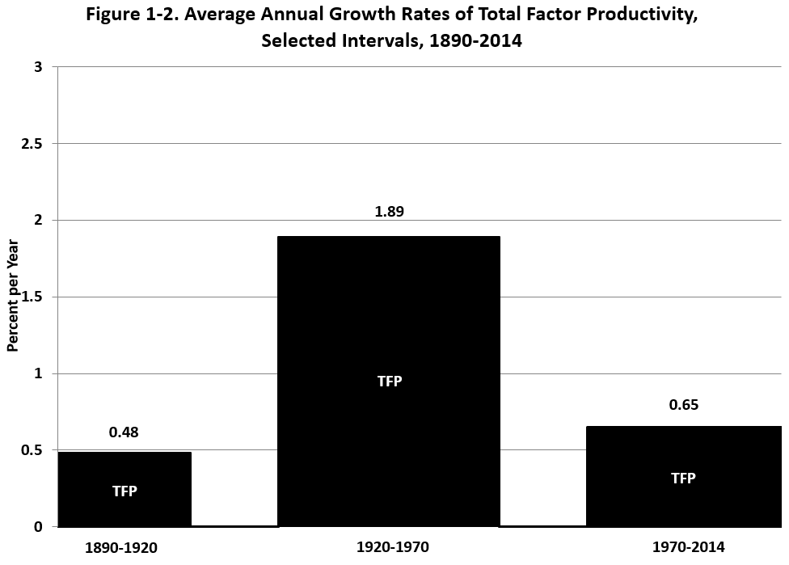
The Three Eras of TFP Growth

Slide 10
TFP Growth 1952-2015, Five-Year Moving Average

Slide 11
IR #3 Has Failed the TFP Test
Failure #1: TFP growth post-1970 barely 1/3 of 1920-70
Failure #2: IR #3 boosted TFP growth only briefly 1996-2004
STARTLING QUESTON: HAS MOST OF THE PRODUCTIVITY IMPACT OF THE THIRD INDUSTRIAL REVOLUTION ALREADY HAPPENED?

Slide 12
IR #3 Changed Business Practices, Pre-Internet Phase 1, 1970-1995
1970 mechanical calculators, repetitive retyping, file cards, filing cabinets
1970s. Memory typewriters, electronic calculators
1980s. PCs with word processing and spreadsheets
Late 1980s, before the arrival of the internet.
E-mail, electronic catalogs, PCs connected inside firms, proprietary software

Slide 13
Completing the Change, 1995-2005
Late 1990s. The web, search engines, e-commerce
2000-05 flat screens, airport check-in kiosks
By 2005 the revolution in business practices was almost over

Slide 14
Paper to Electronic Catalogs, A Transition Completed by 2005
Previous catalogs on cards or paper
University and public libraries
Parts departments at auto dealers
Ordering items at hardware stores
Selecting plants at nurseries/ garden shops
Electronic catalogs have in common
Not only are items listed and pictured
Available inventory, out-of-stock is indicated
Same information available in multiple locations, including at home

Slide 15
Summary: Stasis Everywhere You Look
Offices use desktop and laptop computers much as they did 10-15 years ago
Retail stasis. Shelves stocked by humans, meat sliced at service counters, bar-code checkout
Finance. ATMs, billion-share days
Medicine: electronic medical records are here, little change in what nurses and doctors do
Higher Education: cost inflation comes from rising ratio of administrative staff to instructional staff

Slide 16
TFP Growth 1952-2015, Five-Year Moving Average

Slide 17
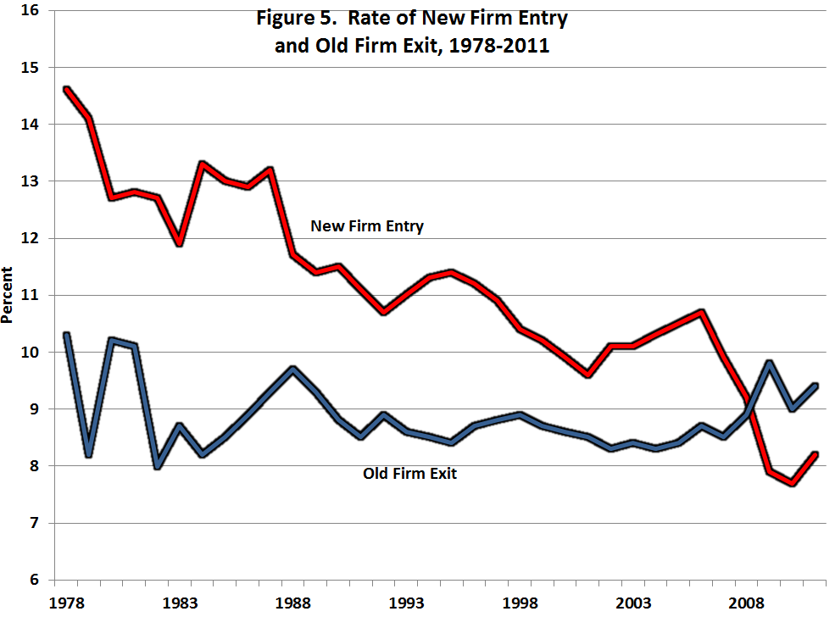
Declining Business “Dynamism” Measured by New Firm Entry

Slide 18
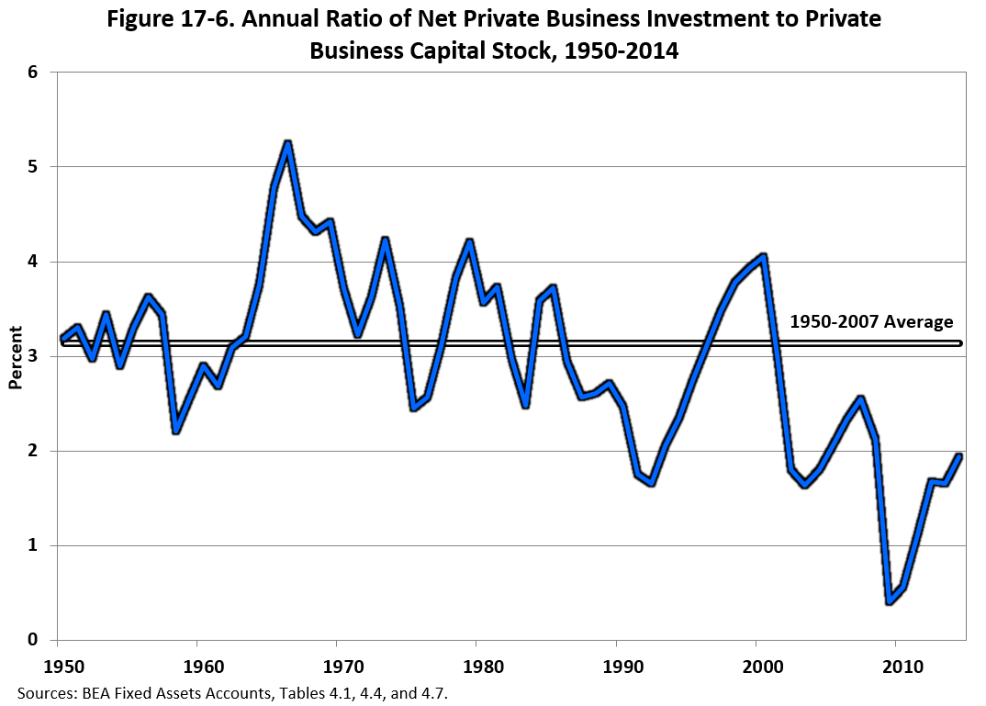
Stagnation Symptom #2: Declining Rate of Net Investment

Slide 19
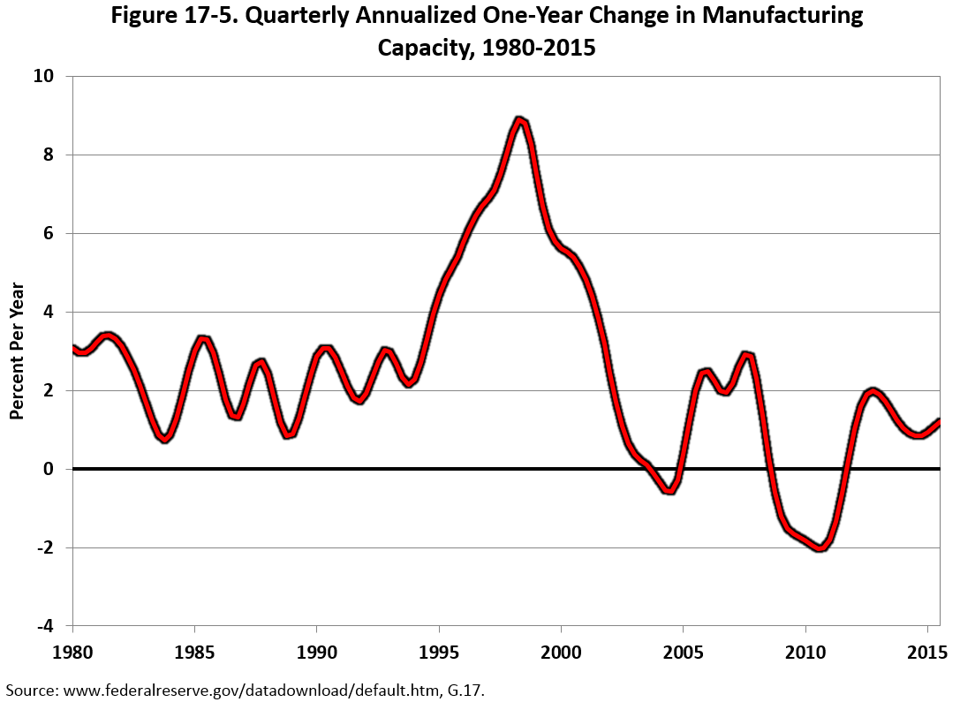
Stagnation Symptom #3: Growth in Manufacturing Capacity

Slide 20
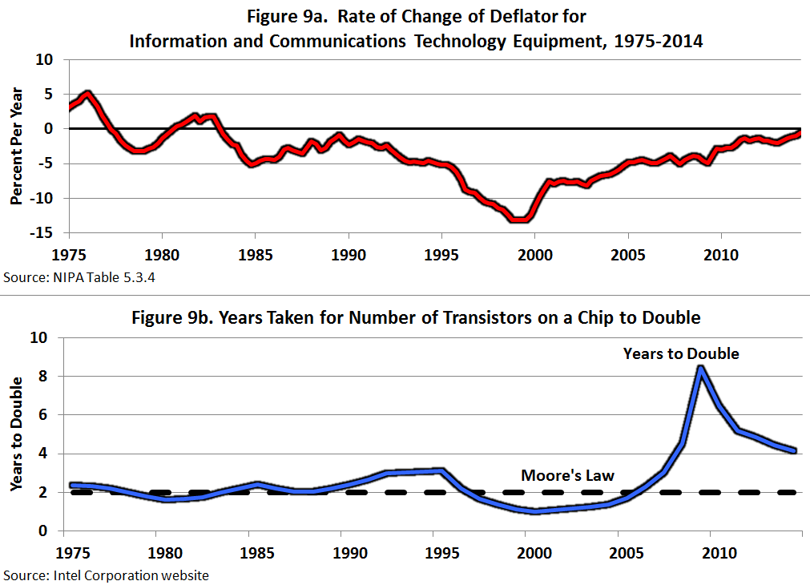
#4 and #5: Computer Prices and the Demise of “Moore’s Law”

Slide 21
Innovations Continue But How Important Are They? (I only look ahead 25 years)
Medical Care (Spending 17% of GDP)
Life expectancy fell 2015 vs. 2014
US lower than Canada, Europe, and Japan
Stunning new report on death rates of whites aged 45-54
Life expectancy gap rich vs. poor (87 vs. 73)
Coming collision between physical wellness and mental illness (Alzheimers)

Slide 22
Innovations Continue But How Important Are They?
3-D Printing
Greatly speeded up speed and efficiency of designing prototypes, not mass production
Robots
Robots date back to 1961, by mid-1990s were welding and painting auto bodies
Robot description from NYT

Slide 23
Innovations Continue But Are Evolutionary Not Revolutionary
Driverless Cars and Trucks
Truck drivers don’t just drive trucks, they unload them and stock the shelves
Evaluation from Consumer Reports (May 2016)
Artificial Intelligence
Predominant uses of big data are in marketing, zero-sum game
Evolutionary change: legal searches, radiology reading, voice recognition, language translation,
“Robo-advice”
Evaluation of AI from business executives

Slide 24
Will Computers Take Away All the Jobs?
Famous Study by Frey and Osborne
Computers will replace 47% of jobs within the next decade
Let’s look at some of their examples
Real world: Computers are complements not just substitutes, reallocate rather than eliminate
ATMs did not make bank tellers disappear
Bar-code scanning did not make clerks disappear
Radiologists have not disappeared, their work has become more accurate

Slide 25
Genuine Reasons for Worry
Job “Polarization” Fosters Rising Inequality
Increased demand for highly skilled technical jobs, designing and working with computers
Increased demand for low-skilled jobs, making beds and flipping burgers
Decreased demand for middle-skill blue-collar and clerical workers
Nothing new:
telephone operators and travel agents, ongoing shift to e-commerce
Increased demand for personal trainers, care for elderly from doctors to helpers

Slide 26
Productivity Growth, Europe vs. US, 1955-2016

Slide 27
Productivity Growth, Europe vs. Asia, 1955-2016

Slide 28
Ratio of Productivity in Asia and Europe to the US, 1955-2016

Slide 29
Slower Growth Goes Beyond Innovation: The Four Headwinds
The slowing contribution of education to economic growth
The demographic headwind
Rising inequality, bottom 99% vs. average including top 1%
The fiscal headwind

Slide 30
First Headwind: Education
A major driver of that epochal 20th century productivity achievement was education
High school completion rate has barely changed since 1970.
Most people drop out of 2-year community colleges
College completion is increasing but 40% of recent graduates are in jobs that do not require a college education
High cost, growing indebtedness

Slide 31
Education: International Comparisons
Poor preparation for college. International PISA test scores rank out of 34 OECD countries: US #17 in reading, 20th in science, 27th in math
U.S. has dropped from #1 to #16 in college completion as percent of population; same for high-school dropouts
This will reduce future economic growth by -0.3 percent per year compared to the contribution of education to 20th century growth

Slide 32
Demographic Headwind: Decline in Hours per Person
Retirement of Baby-Boom Generation
Reduction of Participation of Prime-Age Males
Females 20 and Over
Labor Force Participation Rate rose 35% in 1968 to 58% in 2000, then fell back to 55% in 2012
Source of Declining Growth
Turnaround from rising LFPR due to female entry to falling LFPR due to baby-boom retirement

Slide 33
Third Headwind: Inequality
For 1993-2015 the top 1% earned 52 percent of the total income gain
Top 1% income growth 95%
Bottom 99% income growth 15%
This is continuing, it’s not over. Count the ways
CEO pay, sports and entertainment stars. ($10-15 million)
Wage pushbacks – lower wages, two-tier wages, shaving pension and medical care benefits
Firms pushing employees into part-time work to avoid paying medical care benefits

Slide 34
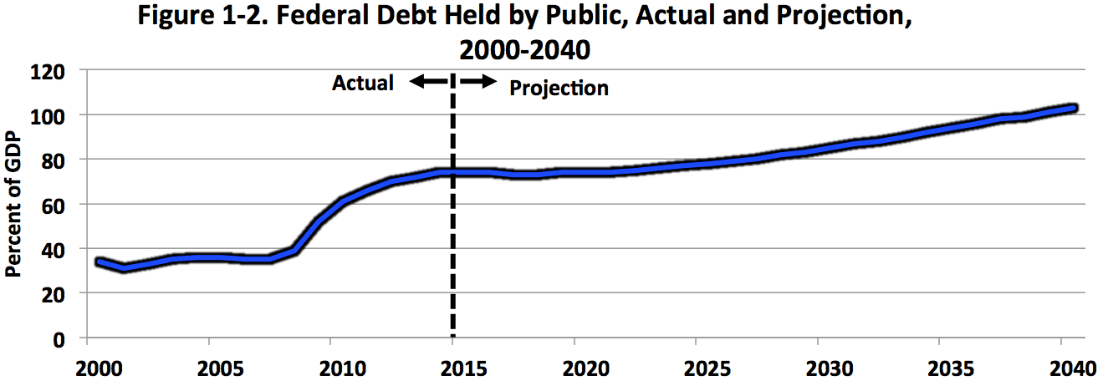

Slide 35
Socioeconomic Changes: The Decline in Marriage
Changes 1982 to 2008, children born out of wedlock
White high school grads 4 to 34 percent
Black high school grads 48 to 74 percent
Change 1960-2010, bottom 1/3 of white population
For 40-year-old women percent of children living with both biological parents declined from 95 to 34 percent

Slide 36
Adverse Future Implications
Future consequences of single-parent households
More children growing up in poverty
Greater likelihood of future high-school dropping out
Less likelihood of completing college
Other indicators of low human capital
46 percent of 20-24 age black males in Chicago are neither at work nor in school (NY & LA 32 percent)
1979-2009 percent of white high school dropouts with prison records 4 to 28 percent
Blacks 15 to 68 percent

Slide 37
Combined Effects of Headwinds
Education headwind reduces productivity growth
Demographic headwind reduces hours per person
Inequality headwind reduces median growth below average growth
Fiscal headwind raises taxes or reduces transfer payments

Slide 39
Conclusions
70 percent of all TFP growth since 1890 occurred 1920-70, attributed to IR #2
The big impacts on TFP of IR #3 were largely completed by 2005
Innovation continues but has less impact
Much of the slowdown in future growth is caused by the headwinds
A moderate pace of innovation means that jobs will not disappear en masse as predicted by the techno-optimists

