Slide 1
Perspectives on Future Inflation
Robert J. Gordon
Northwestern University and NBER
Macro Advisers Outlook Conference
March 24, 2016

Slide 2
My Inflation Model: Basic Elements
Start from naïve Phillips curve, inflation depends on 4 quarterly lags of inflation and current unemployment gap
NAIRU estimated endogenously
Add: long lags (24 on inflation, 0-4 unemployment)
Short-term U vs. total U (periods since 2007)
Food-energy and import prices
Change in productivity growth trend

Slide 3
Role of the Short-term Unemployment Rate

Slide 4
Eight-quarter Change in Productivity Growth Trend

Slide 5
Challenging Test for Any Inflation Model: Dynamic Simulations
Estimate through part of history, say to 1995
Using those coefficients and holding the NAIRU constant, calculate inflation rate, feeding back lagged values of inflation
Simulation data on inflation is calculated, while data on unemployment and other variables is taken as given.
Drift of simulation reveals specification error

Slide 6
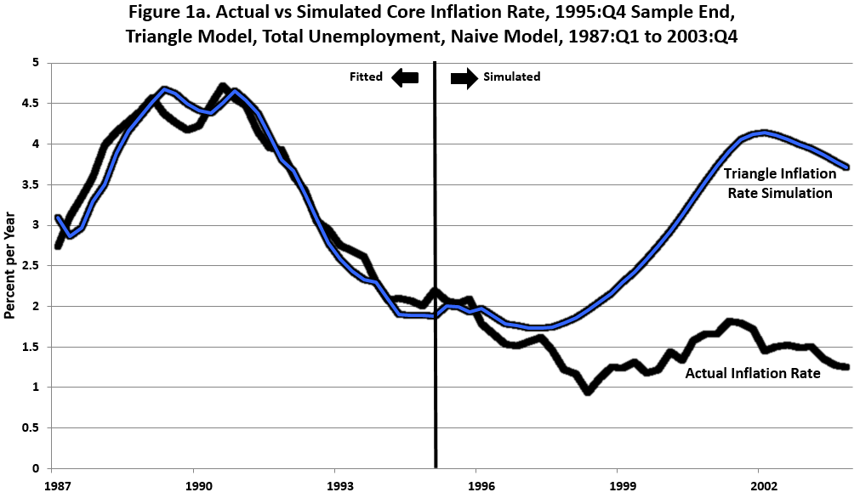
Naïve Model, 1996-2003

Slide 7
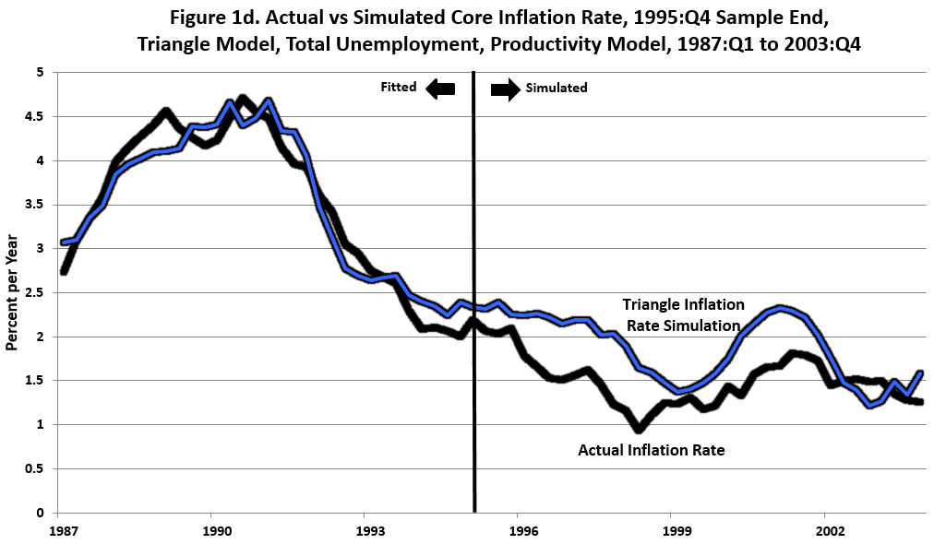
Complete Model, 1996-2003

Slide 8
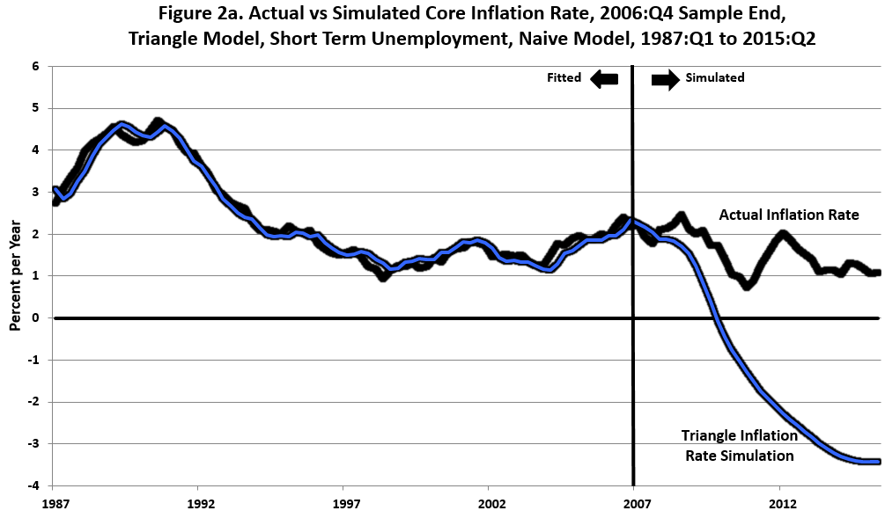
Naïve Model, 2007-2015

Slide 9
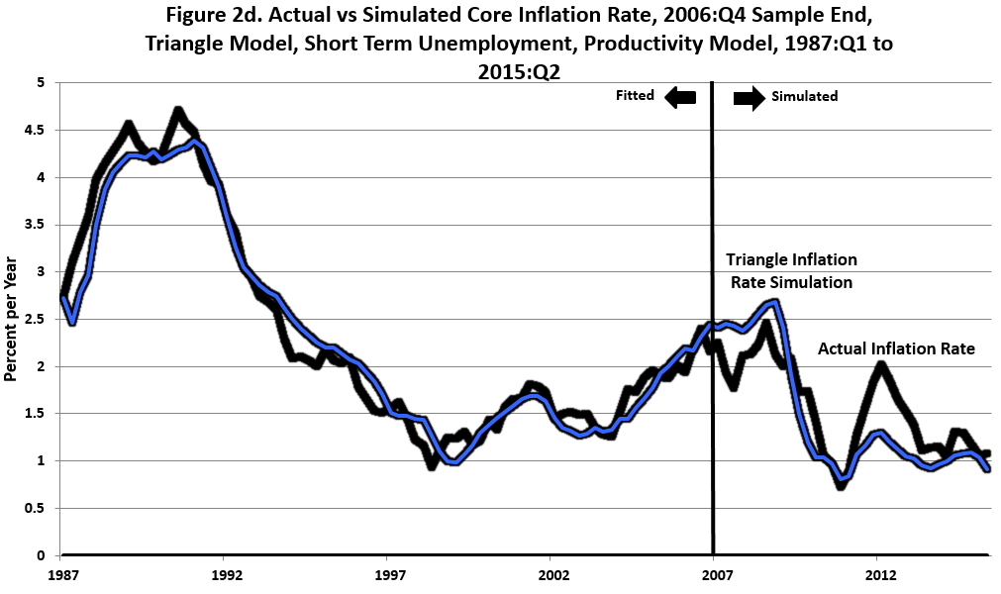
Complete Model, 2007-2015

Slide 10
Short-term Unemployment, Actual, NAIRU, and Forecasts

Slide 11
Future Forecasts Driven Only by Unemployment Gap
Forecasts are for core inflation, not headline inflation
Zero contribution to inflation, up or down, from:
Food-energy prices
Import prices
Changes in productivity trend
Notice very slow response of inflation to a prolonged negative unemployment gap

Slide 12
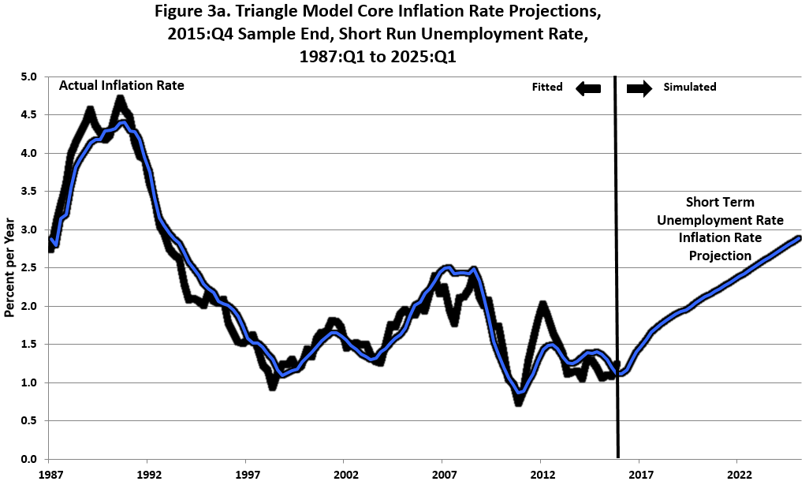
Complete Model 2016-2025

Slide 13
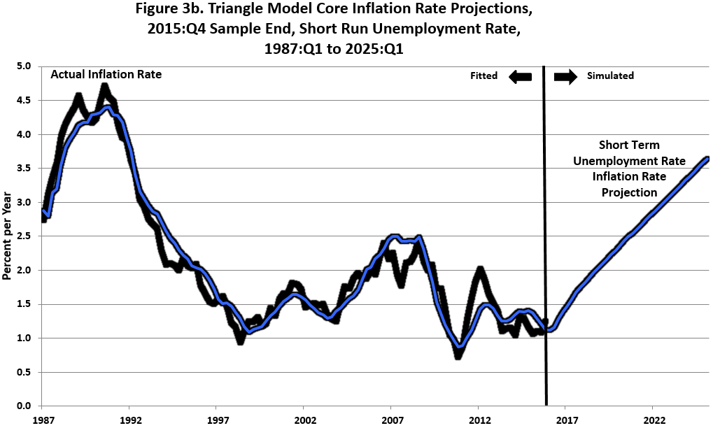
Complete Model, 2016-2025

Slide 14
The Pace of Accelerating Inflation
Total Unemployment 4.5 4.0
Short-term Unemployment 3.5 3.25
Core inflation:
2016:Q1 1.33 1.33
2018:Q1 1.83 1.92
2020:Q1 2.14 2.47
2022:Q1 2.45 2.96
2024:Q1 2.79 3.48

Slide 15
Conclusion
Inflation rises each year by only about 1/3 of the unemployment gap
Substantial room for absorption of long-term unemployed and discouraged workers without breaching Fed’s inflation target
Expansion may die of old age before inflation rises above 2 percent on a sustained basis

