Slide 1
Major Themes in the Slowing of Economic Growth
Robert J. Gordon
Northwestern University and NBER
CUNY Conversation with Paul Krugman
March 4, 2016

Slide 2
The Slowing of Economic Growth Over Three Eras
The Special Century 1870-1970 divided in half: 1870-1920 and 1920-1970
The near half-century since 1970
First question, why does it appear that US GDP per person grew steadily at 2 percent?
Growth in output per person differs from output per hour when there are changes in hours per person

Slide 3
Growth in Y/N, Y/H, and H/N

Slide 4
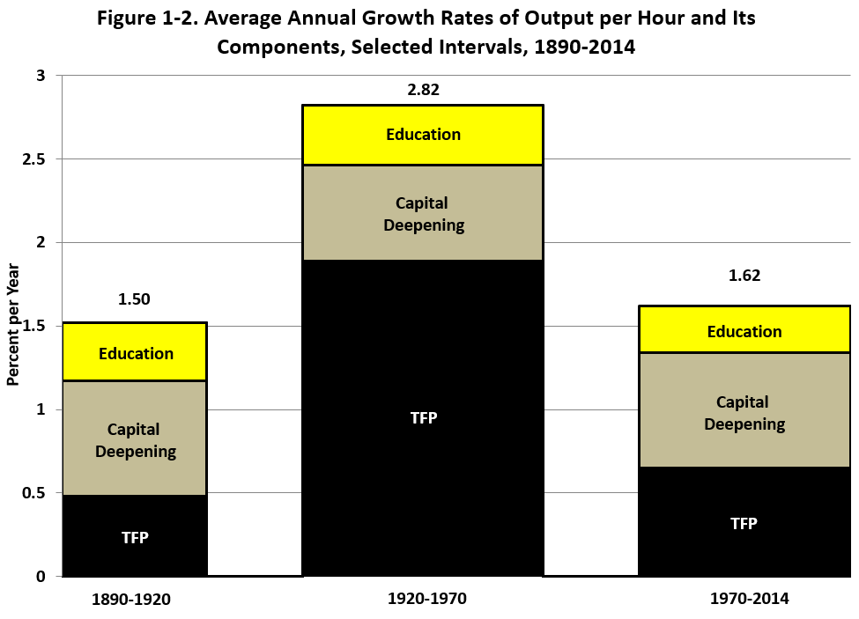
The Three Eras of Productivity Growth

Slide 5
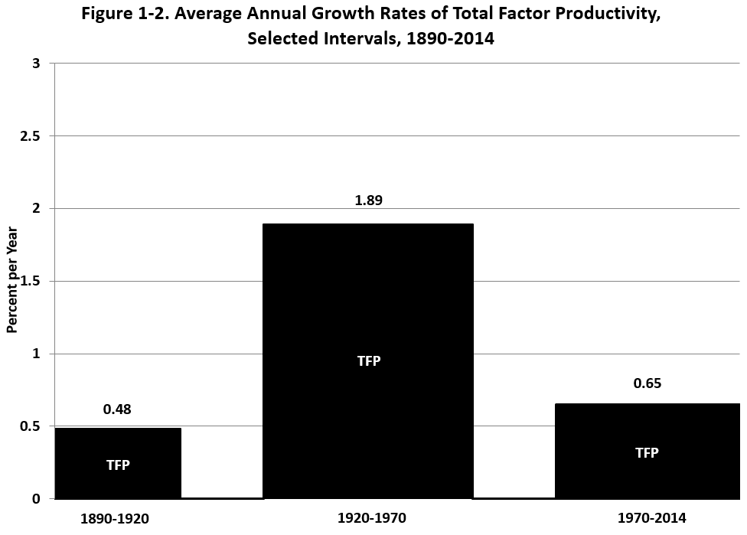
The Three Eras of TFP Growth

Slide 6
The 2nd IR Occurred 1870-1920, Continued Impact through 1970
At least 6 dimensions
Electricity: light, elevators, machines, air conditioning
Internal combustion engine: vehicles, air transport
EIC: Telephone, phonograph, movies, radio, TV
Running water, sewer pipes, and the conquest of infant mortality
Chemicals, plastics, antibiotics, modern medicine
Utter change in working conditions, job & home

Slide 7
Changes in Standard of Living Not Included in GDP
Carrying pails of water >> running water
Outhouses >> indoor bathrooms
Infant mortality 20% >> infant mortality 1%
Child labor. 1890 almost half of 14-15 year old boys were in the labor force >> almost none after 1940
Isolation -> telephone + phonograph + radio + TV
Work and home from cold and hot to uniform temperature due to central heat & air conditioning

Slide 8
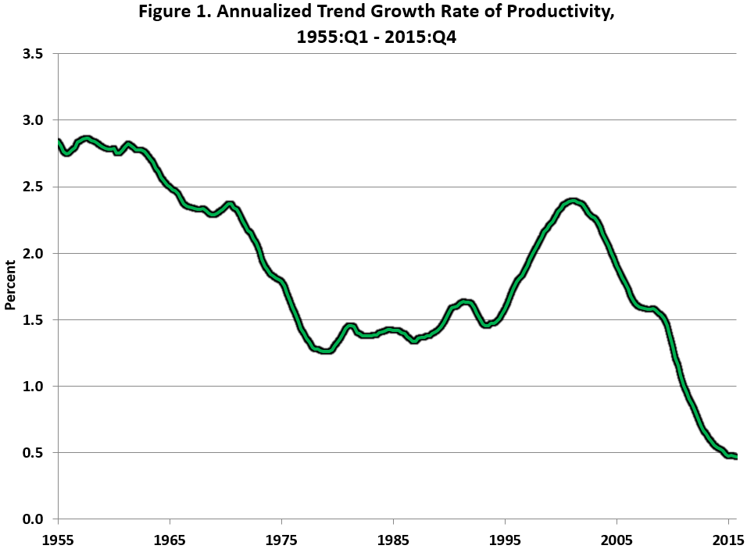
The 60 Years Since 1955

Slide 9
How to Interpret the 1995-2004 Productivity Growth Revival Followed by Growth Slowdown?
Comparing 1970 with 2005, there was a quantum leap increase in the LEVEL of labor productivity
This translates into a temporary hump in the GROWTH RATE of labor productivity
Let’s be specific about the advances that created the quantum leap

Slide 10
IR #3 Changed Business Practices Completely 1970-2005
1970 mechanical calculators, repetitive retyping, file cards, filing cabinets
1970s and 1980s. Memory typewriters, electronic calculators, PCs with word processing and spreadsheets.
1990s. The web, search engines, e-commerce
2000-05 flat screens became ubiquitous
Walking around, you see those same flat screens as in 2005 checking in and checking out
dr, dentist, vet, pet store, pharmacy, bakery, even the econ department.

Slide 11
Why Slow Productivity Growth Since 2010? Stasis in How Business Operates Day-to-Day
Offices use desktop computers with proprietary and web information much as they did 10-15 years ago
Retail stasis. Shelves stocked by humans, meat sliced at service counters, checkout bar-code scanning by humans
Medicine: little change in what nurses and doctors do, one-time transition to electronic records
Higher Education: cost inflation comes from rising ratio of administrative staff to instructional staff

Slide 12
The 60 Years Since 1955

Slide 13
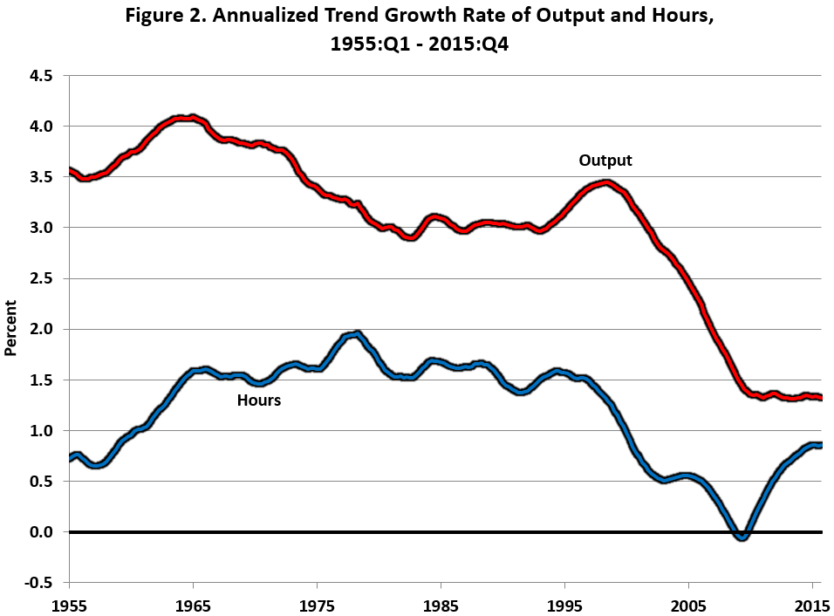
Growth in Trend Output and Hours

