Slide 1
The Past and Future of American Economic Growth
Robert J. Gordon
The New School
New York City, April 25, 2017

Slide 2
Why We All Should Care About Economic Growth
Faster economic growth means faster growth of consumption
Auto sales will be higher, e-commerce grow faster
Fewer bricks & mortar stores will be closed
Faster growth means more investment
More output means more jobs
A lower unemployment rate
More people pulled into the labor force
More forced part-time get full-time jobs

Slide 3
The 2% Growth Path 2009-16: Is It Sustainable?
Actual growth of 2% has been fed by employment growth of 1.5%
Faster than population growth of 1.0%
Made possible by decline in unemployment rate from 10.0% in late 2009 to 4.5% today
Unemployment can’t decline much further
(3.9% reached 2000, 4.4% reached 2007)
How rapidly can output grow at a constant unemployment rate?

Slide 4
Growth with the Same Unemployment Rate
Unemployment 4.7% in 1970:Q2, 1986:Q1, and 2016:Q4
Actual real GDP growth:
1970-2006 3.2 2006-16 1.3
Sources of Slowing GDP growth
Output per Hour (1.8 to 0.9)
Hours of Work (1.4 to 0.4)
Population 16+ (1.4 to 1.0)
Hours per Person (0.0 to -0.6)

Slide 5
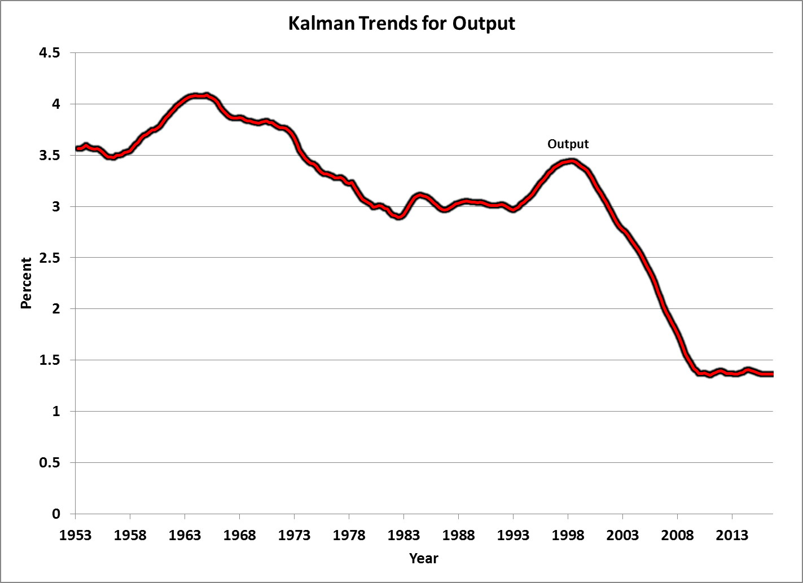
Slowing Real GDP Growth Trend

Slide 6
Slowing Growth Trend in Output per Hour

Slide 7
Slowing Growth Trend in Hours of Work

Slide 8
Slowing Growth of Population 16+

Slide 9
Growth in Hours per Person Turns Negative

Slide 10
2% Growth Path for Output per Capita? No Longer

Slide 11
Sources of Slowdown: Universal vs. U.S. - Centric
Productivity Growth and Innovation
Shared by all nations in developed world
No mention here of catching-up process in emerging nations
Headwinds: U. S. Falling Behind
Education
Inequality
Socioeconomic and welfare state issues
Job loss, decline of marriage, single-family homes
Life expectancy, mortality

Slide 12
Productivity Growth, U.S. vs. Western Europe

Slide 13
Productivity Growth, U. S. vs. Developed Asia

Slide 14
Slowing Productivity Growth Reflects a Smaller Impact of Innovation
The best organizing principle to think about innovation is to distinguish among the industrial revolutions (IR #1, IR #2, IR #3).
The 1st IR occurred 1770-1840, continued impact through 1900
Steam engine, railroad, steamships
Cotton spinning and weaving
Transition from wood to steel

Slide 15
Second Industrial Revolution: Six Dimensions of Growth
Electricity: Light, power, elevators, streetcars, subways, fixed and portable electric machines, kitchen appliances, air conditioning
Motor Vehicles: Cars and trucks replace horses, personal travel, commercial air transport
Running water and sewers: Female liberation, conquest of infant mortality
Info/Communication/Entertainment. Newspapers, telephone, phonograph, radio, motion pictures, TV
Chemicals. Plastics, antibiotics, modern medicine
Change in working conditions: from hot and dirty agriculture and industry to air-conditioned offices

Slide 16
All the Transitions That Could Only Happen Once
Mainly Rural 1870 => Mainly Urban 1950
Light: Polluting Flames to Instant On-Off
Speed: “Hoof & Sail” => Boeing 707
Inside Temperature: From Cold and Hot =>> Central Heating and Air Conditioning
Instantaneous Communication: telegraph, telephone, radio, television
Bathrooms and running water
Life expectancy improved twice as fast 1900-1950 as 1950-2000

Slide 17
Third Industrial Revolution
Since 1960 the “EICT” Revolution
Entertainment: the evolution of TV from color to time-shifting and streaming
Information Tech – the evolution from mainframes to PCs, the web, and e-commerce
Communications: mobile phones, smart phones
Productivity enhancers: ATM, bar-code scanning, fast credit card authorization

Slide 18
Retrospectives on the Revolutionary Century, 1870-1970
Looking Back at 1867 from 1927
Most of the progress had been made by 1939
Looking Ahead to 2000 from 1939
Looking Ahead to 1939 from 1878

Slide 19
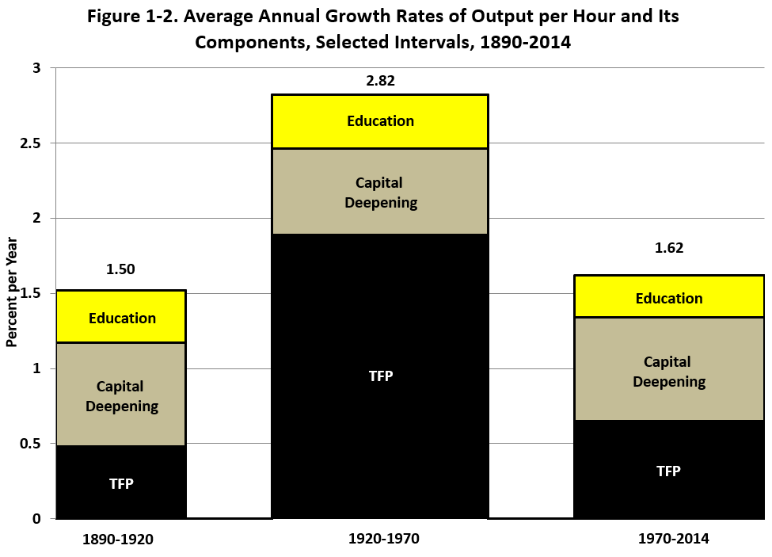
The Three Eras of Productivity Growth

Slide 20
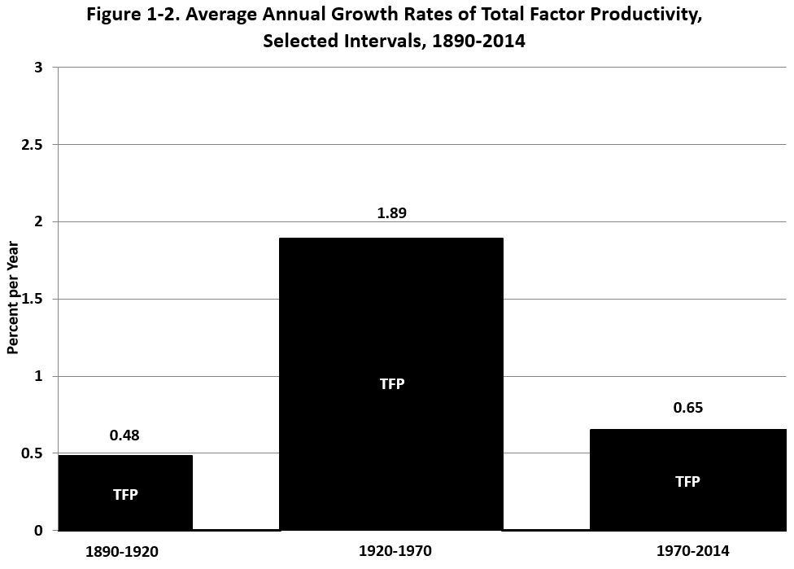
The Three Eras of TFP Growth

Slide 21
What Happened to Make Productivity Growth So Rapid before 1970?
The 2nd IR consisted of at least six dimensions of Great Inventions
Each invention had spinoffs developed over 1890-1970
In contrast the 3rd IR has been limited to one dimension, the ICT revolution
The 2nd IR altered every aspect of life for consumers and business, whereas the 3rd IR mainly mattered for business

Slide 22
TFP Growth 1952-2015, Five-Year Moving Average

Slide 23
IR #3 Has Failed the TFP Test
Failure #1: TFP growth post-1970 barely 1/3 of 1920-70
Failure #2: IR #3 boosted TFP growth only briefly 1996-2004
STARTLING QUESTON: HAS MOST OF THE PRODUCTIVITY IMPACT OF THE THIRD INDUSTRIAL REVOLUTION ALREADY HAPPENED?

Slide 24
IR #3 Changed Business Practices, Pre-Internet Phase 1, 1970-1995
1970 mechanical calculators, repetitive retyping, file cards, filing cabinets
1970s. Memory typewriters, electronic calculators
1980s. PCs with word processing and spreadsheets
Late 1980s, before the arrival of the internet.
E-mail, electronic catalogs, PCs connected inside firms, proprietary software

Slide 25
Completing the Change, 1995-2005
Late 1990s. The web, search engines, e-commerce
2000-05 flat screens, airport check-in kiosks
By 2005 the revolution in business practices was almost over

Slide 26
Paper to Electronic Catalogs, A Transition Completed by 2005
Previous catalogs on cards or paper
University and public libraries
Parts departments at auto dealers
Ordering items at hardware stores
Selecting plants at nurseries/ garden shops
Looking up flights in the Official Airline Guide
Electronic catalogs have in common
Not only are items listed and pictured
Available inventory, out-of-stock is indicated
Same information available in multiple locations, including at home

Slide 27
Summary: Stasis Everywhere You Look
Offices use desktop and laptop computers much as they did 10-15 years ago
Other than e-Commerce, Stasis in Retailing:
Shelves stocked by humans, meat sliced at service counters, bar-code checkout
Finance. ATMs, billion-share days
Medicine: electronic medical records are here, little change in what nurses and doctors do
Higher Education: cost inflation comes from rising ratio of administrative staff to instructional staff

Slide 28
Innovations Continue But How Important Are They?
3-D Printing
Greatly speeded up speed and efficiency of designing prototypes, not mass production
Robots
Robots date back to 1961, by mid-1990s were welding and painting auto bodies
Robot description from NYT

Slide 29
Innovations Continue But Are Evolutionary Not Revolutionary
Driverless Cars and Trucks
Truck drivers don’t just drive trucks, they unload them and stock the shelves
Consumer Reports
Artificial Intelligence
Predominant uses of big data are in marketing, zero-sum game
Evolutionary change: legal searches, radiology reading, voice recognition, language translation,
“Robo-advice”
How Big is the Impact?

Slide 30
Innovation “Bite-Back”
Some Innovations Have Adverse Consequences
Auto deaths increased last year due to distracted driving due to smart phones
Technology has brought viruses, hacking, and identity theft
IT personnel in universities raises expenses, leading to tuition inflation
Clean-energy innovation a reaction to past pollution

Slide 31
TFP Growth 1952-2015, Five-Year Moving Average

Slide 32
Declining Business “Dynamism” Measured by New Firm Entry

Slide 33
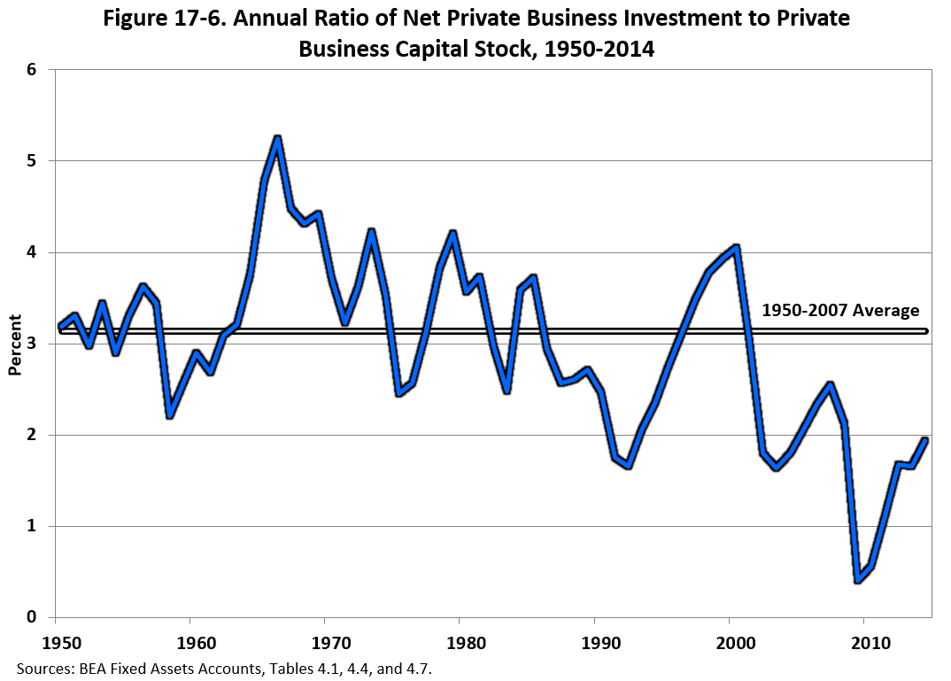
Stagnation Symptom #2: Declining Rate of Net Investment

Slide 34
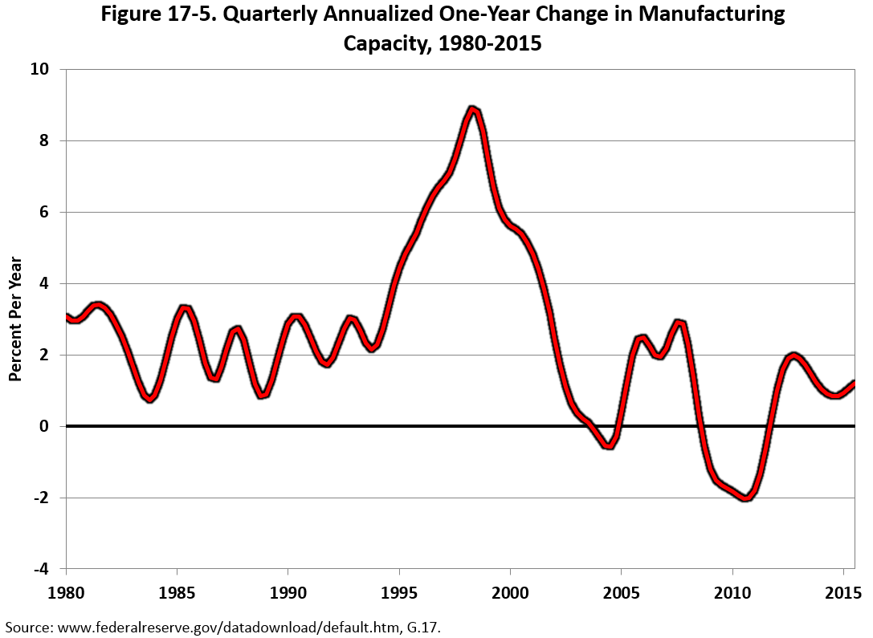
Stagnation Symptom #3: Growth in Manufacturing Capacity

Slide 35
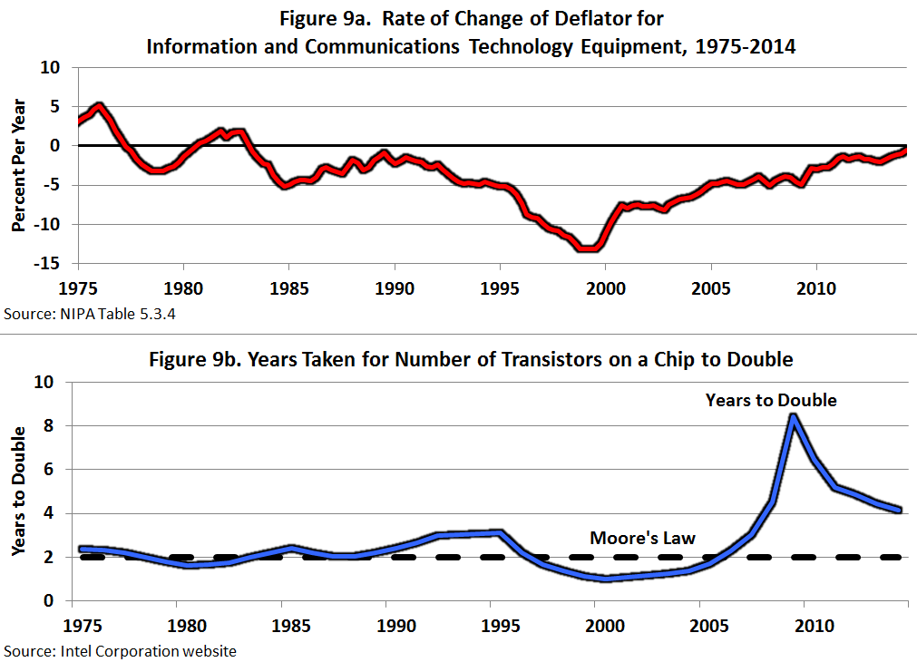
#4 and #5: Computer Prices and the Demise of “Moore’s Law”

Slide 36
Will Computers Take Away All the Jobs?
Famous Study by Frey and Osborne in 2013
Computers will replace 47% of jobs within the next decade
Let’s look at some of their examples
Real world: Computers are often complements not just substitutes, reallocate rather than eliminate
ATMs did not make bank tellers disappear
Bar-code scanning did not make check-out clerks disappear
Radiologists have not disappeared, their work has become more accurate

Slide 37
Genuine Reasons for Worry
Job “Polarization” Fosters Rising Inequality
Increased demand for highly skilled technical jobs
Increased demand for low-skilled jobs, flipping burgers and making beds, personal trainers and in-home care
Decreased demand for middle-skill blue-collar and clerical workers
Social and Economic Consequences for Middle-Aged Men

Slide 38
Middle-Skill Job Loss, Particularly for Men
Extension of the Book’s Discussion of the “Demographic Headwind”
Multiple Consequences of Middle-Skill Job Loss
Clash of actual outcome vs. expectations for a better life
Labor-force drop outs
Less attractive marriage partners, decline of marriage
Consequences of single-family homes for behavior and outcomes of children
Health and mortality consequences

Slide 40
Choice vs. Chance
Loss of stable union jobs with health care, defined benefit pensions
Obstacles to success in service jobs
Women better than men in social skills, social intelligence
Many service jobs require providing services for higher income people
Obstacles to moving for better jobs
Extended families in their locality
Depressed house prices where plants have closed

Slide 41
Demographic Headwind: Decline in Hours per Person
Retirement of Baby-Boom Generation
Source of Declining Growth in Hours Worked
Turnaround from rising LFPR due to female entry to falling LFPR due to baby-boom retirement
Reduction of Participation of Prime-Age Males
From 98% in 1953 to 88% in 2015
High school grads or less, 97% to 84%
Lowest in OECD except for Italy

Slide 42
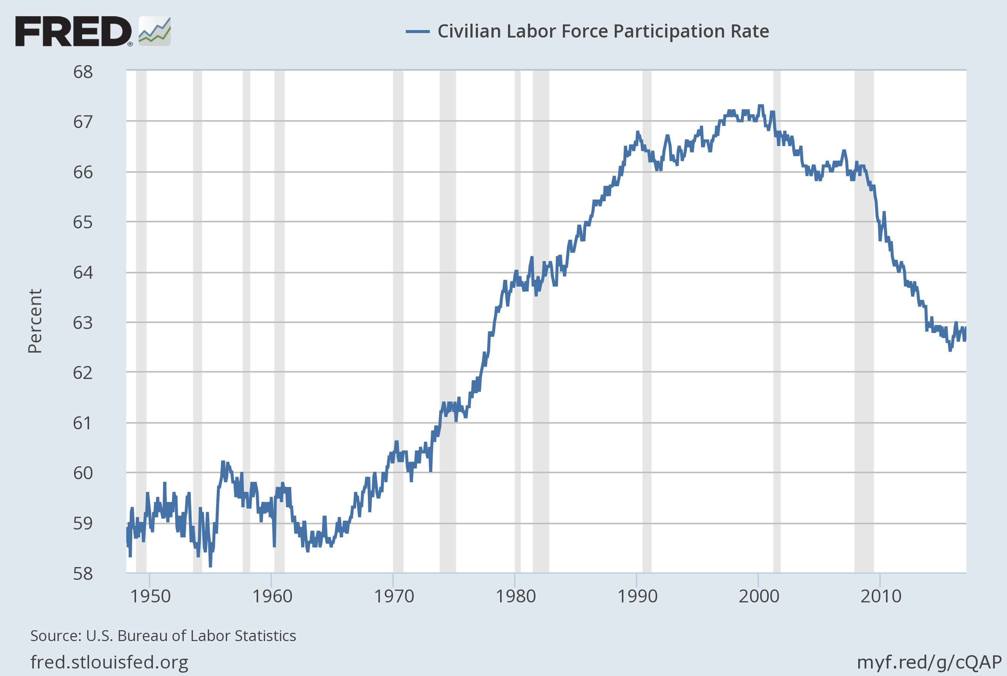
Notes:
Source: U.S. Bureau of Labor Statistics Release: Employment Situation The series comes from the 'Current Population Survey (Household Survey)'The source code is: LNS11300000 U.S. Bureau of Labor Statistics, Civilian Labor Force Participation Rate [CIVPART], retrieved from FRED, Federal Reserve Bank of St. Louis; https://fred.stlouisfed.org/series/CIVPART, February 26, 2017.

Slide 43
Prime Age Male Labor Force Participation Rate

Slide 44
Consequences of Job Loss, Labor Force Dropping Out
Loss of protective institutions
Unions
Catholic Church
Comraderie with co-workers at nearby bar
The compliant wife
Non-college males 51 percent divorce rate
Main reasons: infidelity, domestic violence, substance abuse
Loss of “civilizing influence” of marriage and children

Slide 45
The Decline in Marriage
Women don’t want to marry men who are less well-educated, less successful than they are
Changes 1982 to 2008, children born out of wedlock
White high school grads 4 to 34 percent
Black high school grads 48 to 74 percent
Change 1960-2010, bottom 1/3 of white population
For 40-year-old women percent of children living with both biological parents declined from 95 to 34 percent

Slide 46
Growing Imbalance of College Completion by Sex

Slide 47
Consequences of Single-Parent Families
White families, percent of non-marital births
3.4 percent in 1965; 35.7 percent in 2014
Study of brothers and sisters of single-parent families
Brothers do less well in school disciplinary actions, high school completion, subsequent employment success
Evidence of development of brain function ages 0-2
Absence of parental leave leads to child care too early
Absence of fathers influences brain development of boys
Other indicators of low human capital
1979-2009 percent of white high school dropouts with prison records 4 to 28 percent
Blacks 15 to 68 percent

Slide 48
Mortality Outcomes for Middle-Aged Whites (Case-Deaton)

Slide 49
A Leading Puzzle: The Contrast with Other Countries

Slide 50
This Extended View of the Demographic Headwind: Consequences for Growth
Declining participation reduces growth in hours of work and GDP
Decline and postponement of marriage reduces fertility rate and population growth
Health consequences raise mortality rate
Consequences of single-parent families for children cast shadow on future educational attainment and employability

Slide 51
Slower Growth Goes Beyond Innovation: The Four Headwinds
As above, the demographic headwind
The education headwind
The inequality headwind
The fiscal headwind

Slide 52
Second Headwind: Education
A major driver of that epochal 20th century productivity achievement was education
High school completion rate has barely changed since 1970.
Most people drop out of 2-year community colleges
College completion is increasing but 40% of recent graduates are in jobs that do not require a college education
High cost, growing indebtedness

Slide 53
The Education Plateau

Slide 54
Again, Lack of Progress for Men

Slide 55
Education: International Comparisons
Poor preparation for college. International PISA test scores rank out of 34 OECD countries: US #17 in reading, 20th in science, 27th in math
U.S. has dropped from #1 to #16 in college completion as percent of population; same for high-school dropouts
This will reduce future economic growth by -0.3 percent per year compared to the contribution of education to 20th century growth

Slide 56
Third Headwind: Inequality
For 1993-2015 the top 1% earned 52 percent of the total income gain
Top 1% income growth 95%
Bottom 99% income growth 15%
This is continuing, it’s not over. Count the ways
CEO pay, sports and entertainment stars. ($10-15 million)
Wage pushbacks – lower wages, two-tier wages, shaving pension and medical care benefits
Firms pushing employees into part-time work, hiring “contract workers” instead of employees

Slide 57
The Income Share of the Top One Percent Since 1920

Slide 58
The Life Expectancy Gap by Income Quintile

Slide 59
The Fiscal Headwind

Slide 60
Combined Effects of Headwinds
Demographic headwind reduces hours per person
Education headwind reduces productivity growth
Inequality headwind reduces median growth below average growth
Fiscal headwind raises taxes or reduces transfer payments

Slide 62
Conclusions
70 percent of all TFP growth since 1890 occurred 1920-70, attributed to IR #2
The big impacts on TFP of IR #3 were largely completed by 2005
Innovation continues but has less impact
Much of the slowdown in future growth is caused by the headwinds
Slowing innovation shared across countries, but aspects of headwinds are U.S.-centric
A moderate pace of innovation means that jobs will not disappear en masse

