Slide 1
The Current Growth Slowdown from the Perspective of the Special Century
Robert J. Gordon
Northwestern University and NBER
London School of Economics,
May 11, 2016

Slide 2
Secular Stagnation: The Perspective in 2016
Today 2015: slowing potential GDP growth
Potential Output per Hour
Potential Hours of Work
Working-age Population
Falling Labor-force Participation Rate (LFPR) reduces Hours per capita
Actual real GDP growth: 1974-2004 3.12, 2004-15 1.56

Slide 3
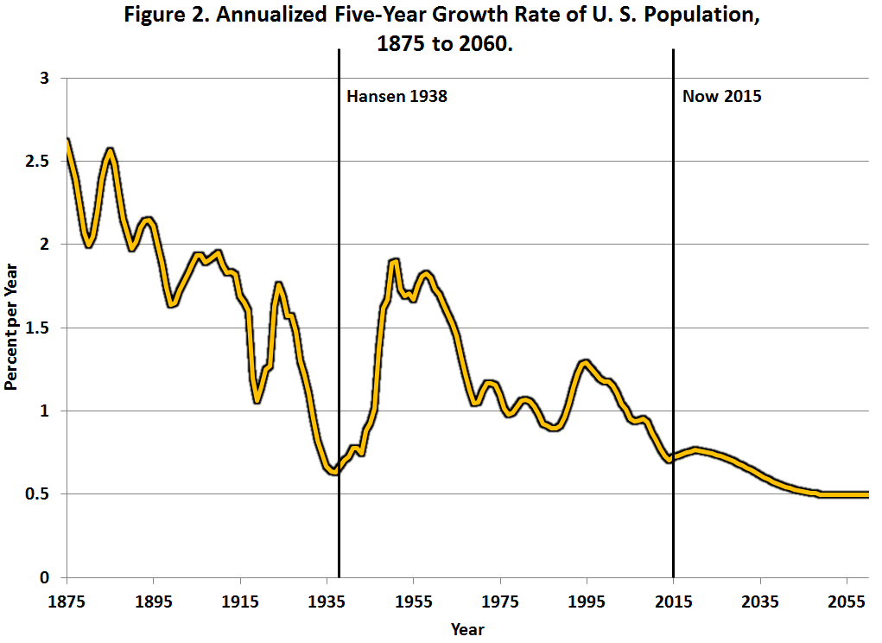
Decline in Population Growth As Seen From 1938 and 2015

Slide 4
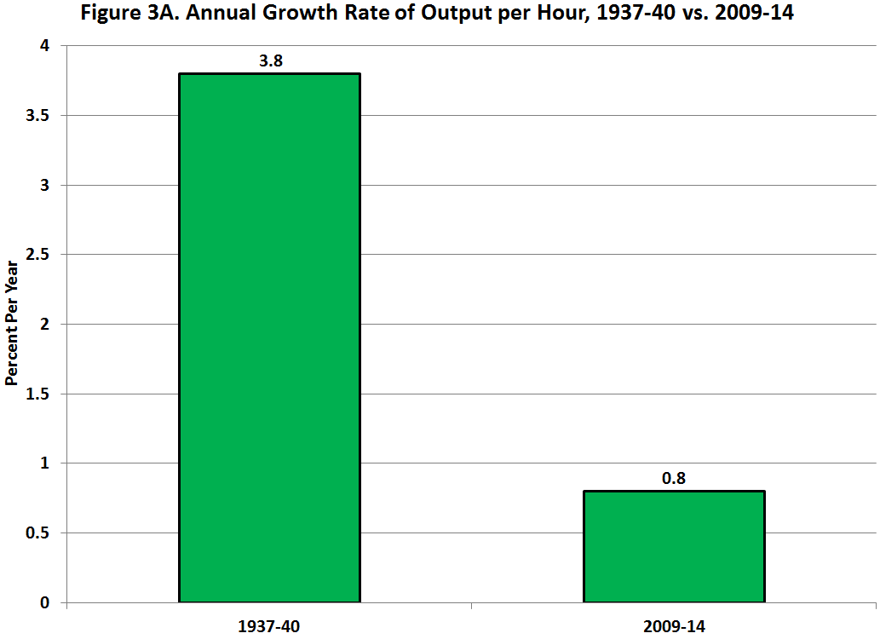
Productivity Growth, 1937-40 vs. 2009-14

Slide 5
Preview: Primary Source of Secular Stagnation is Slowing Productivity Growth
The best organizing principle to think about innovation is to distinguish among the industrial revolutions (IR #1, IR #2, IR #3).
The 1st IR occurred 1770-1840, continued impact through 1900
Steam engine, railroad, steamships
Cotton spinning and weaving
Transition from wood to steel

Slide 6
The 2nd IR occurred 1870-1920, continued impact through 1970
Electricity, light, elevators, machines, air conditioning
Internal combustion engine, vehicles, air transport
Telephone, phonograph, movies, radio, TV
Running water, sewer pipes, and the conquest of infant mortality
Chemicals, plastics, antibiotics, modern medicine
Utter change in working conditions, job & home

Slide 7
Why Did Productivity Grow Faster In the Century Before 1970? The One-Time-Only Inventions
Polluting flames for light >> instant on-off electric light
Factory power with steam engines and belts >> electric machine tools and hand tools
Offices and home cold and hot >> central heating and air-conditioning
Horses >> motor vehicles and air travel
Mainly rural 1870 >> mainly urban 1950

Slide 8
Third Industrial Revolution
Since 1960 the “EICT” Revolution
Entertainment: the evolution of TV from color to time-shifting and streaming
Information Tech – the evolution from mainframes to PCs, the web, and e-commerce
Communications: mobile phones, smart phones
Productivity enhancers: ATM, bar-code scanning, fast credit card authorization

Slide 9
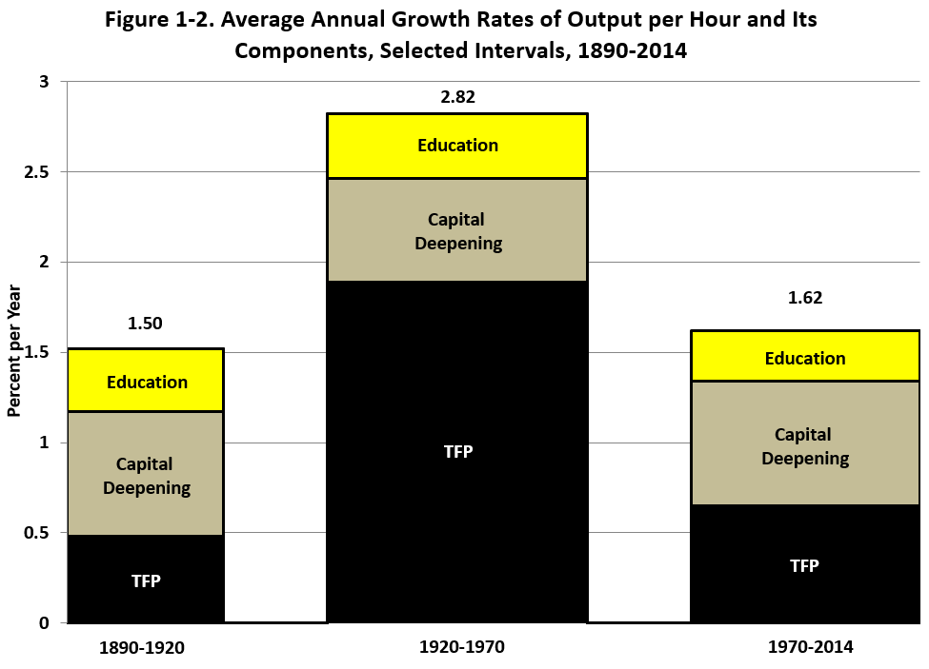
The Three Eras of Productivity Growth

Slide 10
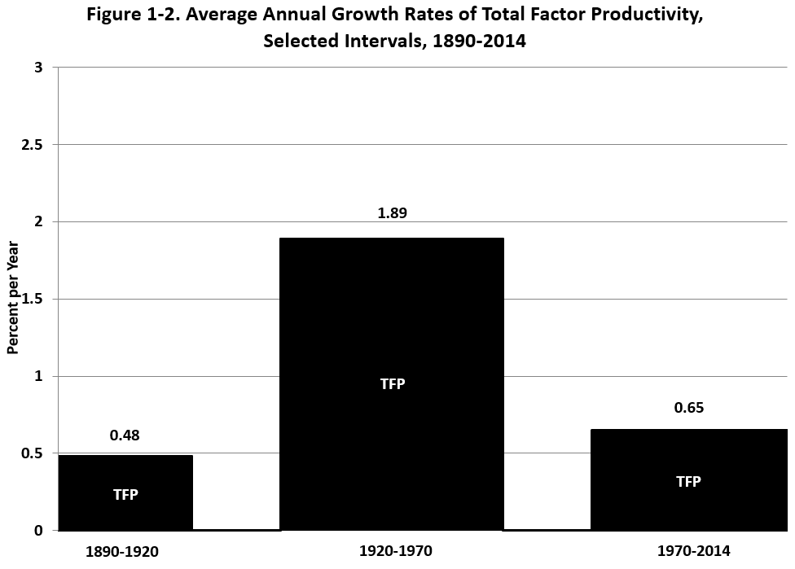
The Three Eras of TFP Growth

Slide 11
TFP Growth 1952-2015, Five-Year Moving Average

Slide 12
IR #3 Has Failed the TFP Test
Failure #1: TFP growth post-1970 barely 1/3 of 1920-70
Failure #2: IR #3 boosted TFP growth only briefly 1996-2004
STARTLING CONCLUSION: HAS THE PRODUCTIVITY IMPACT OF THE THIRD INDUSTRIAL REVOLUTION ALREADY HAPPENED?

Slide 13
IR #3 Changed Business Practices, Pre-Internet Phase 1, 1970-1995
1970 mechanical calculators, repetitive retyping, file cards, filing cabinets
1970s. Memory typewriters, electronic calculators
1980s. PCs with word processing and spreadsheets
Late 1980s. E-mail, electronic catalogs, T-1 lines, proprietary software

Slide 14
Completing the Change, 1995-2005
Late 1990s. The web, search engines, e-commerce
2000-05 flat screens, airport check-in kiosks
By 2005 the revolution in business practices was almost over

Slide 15
Eliminating the Middle in Publishing
Newspaper publishing circa 1994
A newsroom of PC screens (not flat)
By then no linotype operator
Replaced by linked word processing and publication software
Newspapers, magazines, books, academic papers
The whole layer of secretaries, typesetters, middlemen had been eliminated before web browsers arrived

Slide 16
Paper to Electronic Catalogs
Transformation from 1985 to 2005
University and public libraries
Parts departments at auto dealers
Ordering items at hardware stores
Selecting plants at nurseries/ garden shops
All of these uses have in common
Not only are items listed and pictured
Available inventory, out-of-stock is indicated
Same information available at home as in the library or in the store

Slide 17
Transformation in Retailing Completed by 2005
1980s and 1990s Wal-Mart led big box revolution with innovations in supply chain and inventory management
Check-out revolution: bar-code scanners, credit/debit card authorization technology
Impact of self check-out surprisingly small (is it surprising?)

Slide 18
More Achievements Completed by 2005
Finance and Banking
1970s and 1980s, ATM machines
1980s and 1990s. Transition from multi-million share trading days to multi-billion share days
Commonplace now: empty bank branches
How Long Ago Were the Creations:
Amazon 1994, Google 1998, Wiki and i-tunes 2001, Blackberry 2003, Facebook 2004, iPhone 2007

Slide 19
Summary: Stasis Everywhere You Look
Offices use desktop computers and proprietary information as they did 10-15 years ago
Retail stasis. Shelves stocked by humans, meat sliced at service counters, checkout bar-code scanning.
Medicine: electronic medical records largely rolled out, little change in what nurses and doctors do
Higher Education: cost inflation comes from rising ratio of administrative staff to instructional staff

Slide 20
TFP Growth 1952-2015, Five-Year Moving Average

Slide 21
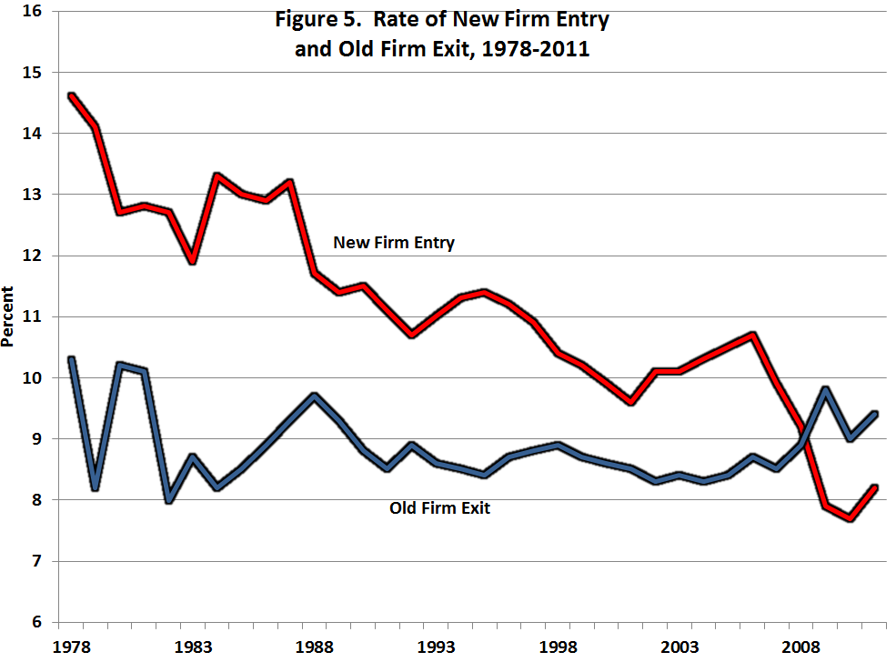
Declining Business “Dynamism” Measured by New Firm Entry

Slide 22
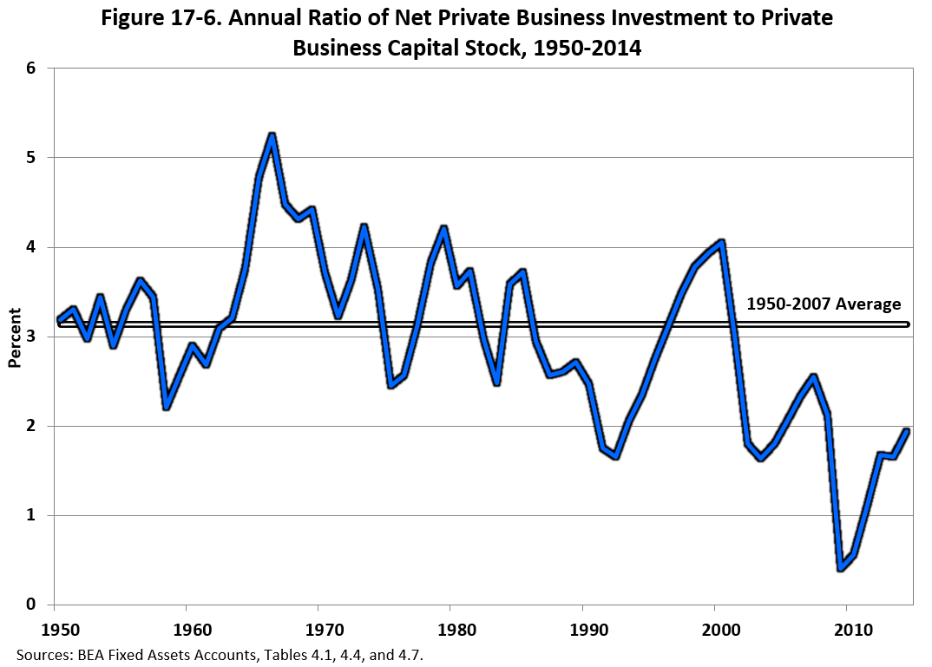
Stagnation Symptom #2: Declining Rate of Net Investment

Slide 23
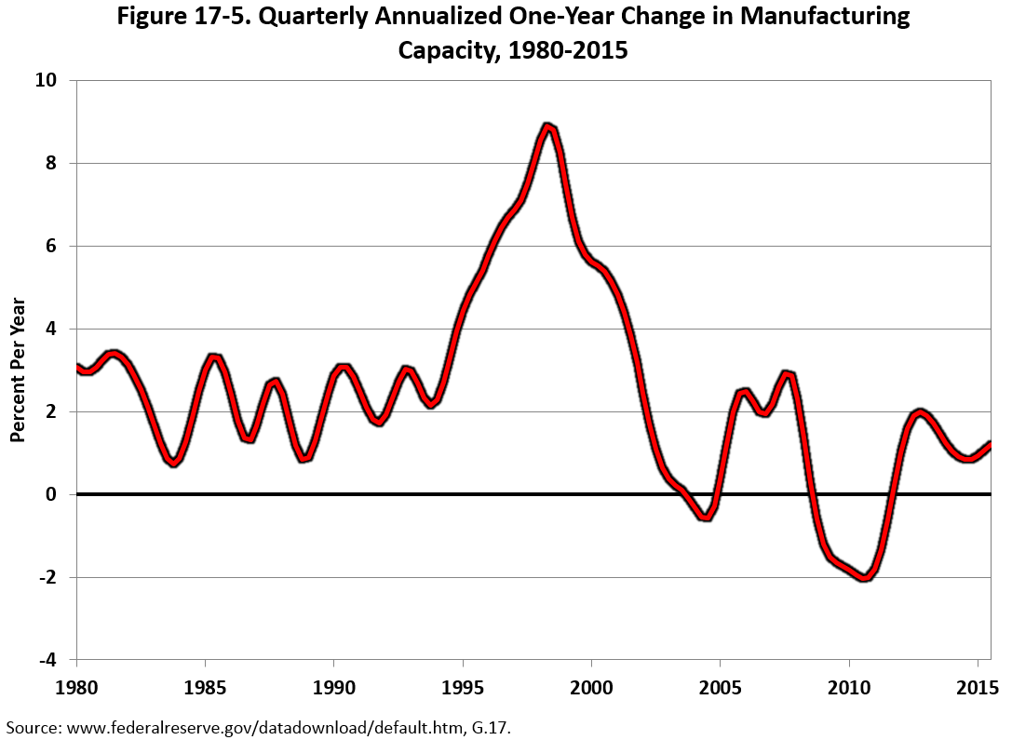
Stagnation Symptom #3: Growth in Manufacturing Capacity

Slide 24
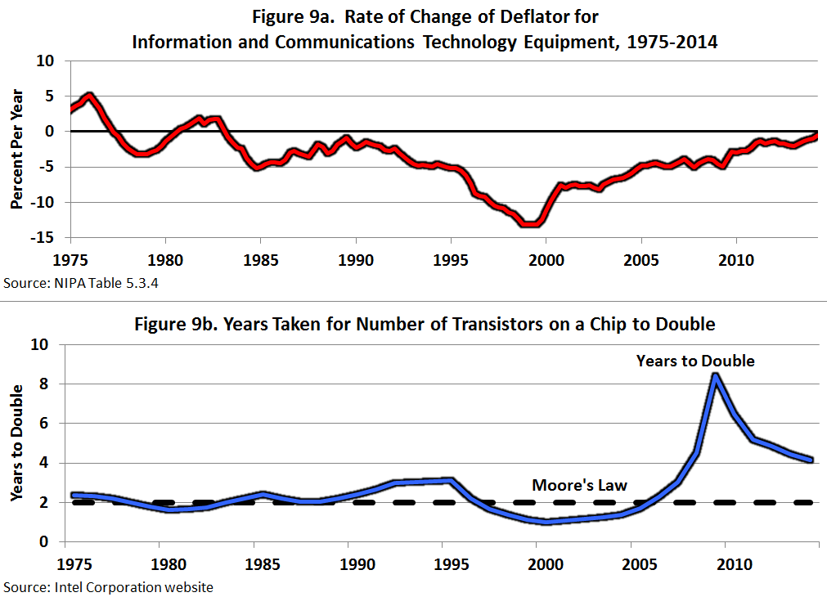
#4 and #5: Computer Prices and the Demise of “Moore’s Law”

Slide 25
Innovations Continue But How Important Are They? (I only look ahead 25 years)
Medical Care
Life expectancy fell 2015 vs. 2014
US lower than Canada, Europe, and Japan
Stunning new report on death rates of whites aged 45-54
Life expectancy gap rich vs. poor (87 vs. 73)
Coming collision between physical wellness and mental illness (Alzheimers)

Slide 26
Innovations Continue But How Important Are They?
Small Robots
Robots date back to 1961, continued development is evolutionary not revolutionary
Robot description from NYT
3-D Printing
Greatly speeded up speed and efficiency of designing prototypes, not mass production

Slide 27
Innovations Continue But Are Evolutionary Not Revolutionary
Artificial Intelligence
Predominant uses of big data are in marketing, zero-sum game
Evolutionary change: legal searches, radiology reading, voice recognition, language translation,
“Robo-advice”
Driverless Cars and Trucks
Truck drivers don’t just drive trucks, they unload them and stock the shelves
Evaluation from Consumer Reports (May 2016)

Slide 28
Slower Growth Goes Beyond Innovation: The Four Headwinds
The slowing contribution of education to economic growth
The demographic headwind
Rising inequality, bottom 99% vs. average including top 1%
The fiscal headwind

Slide 29
First Headwind: Education
A major driver of that epochal 20th century productivity achievement was education
High school completion rate has barely changed since 1970.
Most people drop out of 2-year community colleges
College completion is increasing but 40% of recent graduates are in jobs that do not require a college education
High cost, growing indebtedness

Slide 30
Education: International Comparisons
Poor preparation for college. International PISA test scores rank out of 34 OECD countries: US #17 in reading, 20th in science, 27th in math
U.S. has dropped from #1 to #16 in college completion as percent of population; same for high-school dropouts
This will reduce future economic growth by -0.3 percent per year compared to the contribution of education to 20th century growth

Slide 31
Demographic Headwind: Decline in Hours per Person
Retirement of Baby-Boom Generation
Reduction of Participation of Prime-Age Males
Youth
Employment/Population Ratio 65% in 1988 to 46% in 2012. Only about 1/3 of this decline is accounted for by increased school participation
Females 20 and Over
Labor Force Participation Rate rose 35% in 1968 to 58% in 2000, then fell back to 55% in 2012

Slide 32
Third Headwind: Inequality
For 1993-2012 the gap between average real income growth of total vs. bottom 99% is
-0.53 percent per year.
This is continuing, it’s not over. Count the ways
CEO pay, sports and entertainment stars. ($10-15 million)
Wage pushbacks – lower wages, two-tier wages, shaving pension and medical care benefits
Firms pushing employees into part-time work to avoid paying medical care benefits

Slide 33
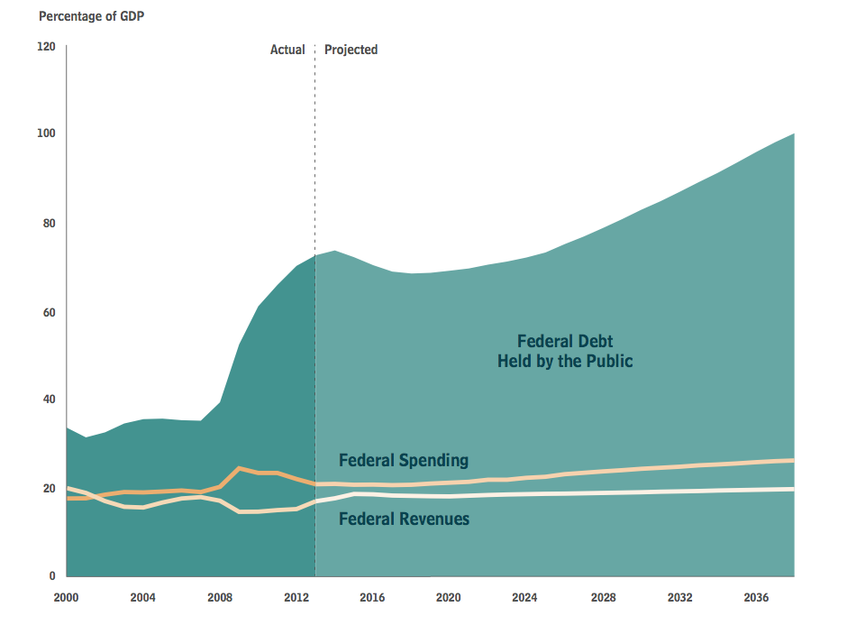
The Fiscal Headwind: Future Debt-GDP Ratio Adverse Future Implications
Future consequences of single-parent households
More children growing up in poverty
Greater likelihood of future high-school dropping out
Greater likelihood of criminal activity
Additional adverse effects: 1979-2009 percent with prison records
white high school dropouts with prison records 4 to 28 percent
blacks 15 to 68 percent

Slide 34
Socioeconomic Changes: The Decline in Marriage
Changes 1982 to 2008, children born out of wedlock
White high school grads 4 to 34 percent
Black high school grads 48 to 74 percent
Change 1960-2010, bottom 1/3 of white population
For 40-year-old women percent of children living with both biological parents declined from 95 to 34 percent

Slide 35
Adverse Future Implications
Future consequences of single-parent households
More children growing up in poverty
Greater likelihood of future high-school dropping out
Less likelihood of completing college
Additional adverse effects:
46 percent of 20-24 age black males in Chicago are neither at work or in school (NY & LA 32 percent)
1979-2009 percent of white high school dropouts with prison records 4 to 28 percent
Blacks 15 to 68 percent

Slide 36
Combined Effects of Headwinds
Education headwind reduces productivity growth
Demographic headwind reduces hours per person
Inequality headwind reduces median growth below average growth
Fiscal headwind raises taxes or reduces transfer payments

Slide 38
Conclusions
70 percent of all TFP growth since 1890 occurred 1920-70, attributed to IR #2
The big impacts on TFP of IR #3 were largely completed by 2005
Innovation continues but is less important
Much of the slowdown in future growth is caused by the headwinds
A moderate pace of innovation means that jobs will not disappear en masse as predicted by the techno-optimists

