Slide 1
AI and Employment: Misplaced Fears
Robert J. Gordon
MIT Conference on AI and the Future of Work
Cambridge MA, November 2, 2017

Slide 2
AI: A Creator of Mass Unemployment?
No invention in 250 years since the First Industrial Revolution has created Mass Unemployment
The unemployment rate is now 4.2 percent
16 million new jobs have been created since 2009
Monetary policy has achieved low unemployment and can continue to do so
Enormous churn in labor market. August 6.1m job openings, 5.4m hires, 5.2m separations of which 3.1m were voluntary quits
Job losses from AI will be quickly offset by new jobs
Shortages of workers: skilled manufacturing, construction, even long-distance truck drivers

Slide 3
Concern About Quality of Jobs? Nothing New and Nothing About AI
Concern about polarization, hollowing out of the middle jobs, a familiar theme for last 15 years
Concern about rising inequality a familiar theme for last 40 years
Concerns for more than 40 years: mismatch of jobs by skill and location, low pay for unskilled workers
New concern, shrinkage of labor’s income share
Surprising but true: 2006-16 skill mix increased – more good than bad jobs were created

Slide 4
What’s New About AI and Robots?
Robots? First in 1961, plentiful by 1995
Mainly in manufacturing, few in service sector, almost none in education or health care
Amazon’s warehouse robots haven’t prevented massive increase of employment in e-commerce
AI’s creation dates back to 1957
IBM’s Deep Blue beat Kasparov in 1997
IBM’s Watson won at Jeopardy in 2011
What does AI involve besides games?

Slide 5
Job Displacement Varies from Severe to Minor
Airline and hotel reservations system replaced most travel agents
Voice recognition and language translation have replaced many transcribers and translators
Computer phone menus replaced some customer service agents
Bar-code scanning didn’t replace check-out clerks
Computerized radiology scans have not displaced radiologists, who still are required to sign off
Most spending on AI is in marketing, but marketing analyst jobs have flourished
McKinsey Quarterly survey

Slide 6
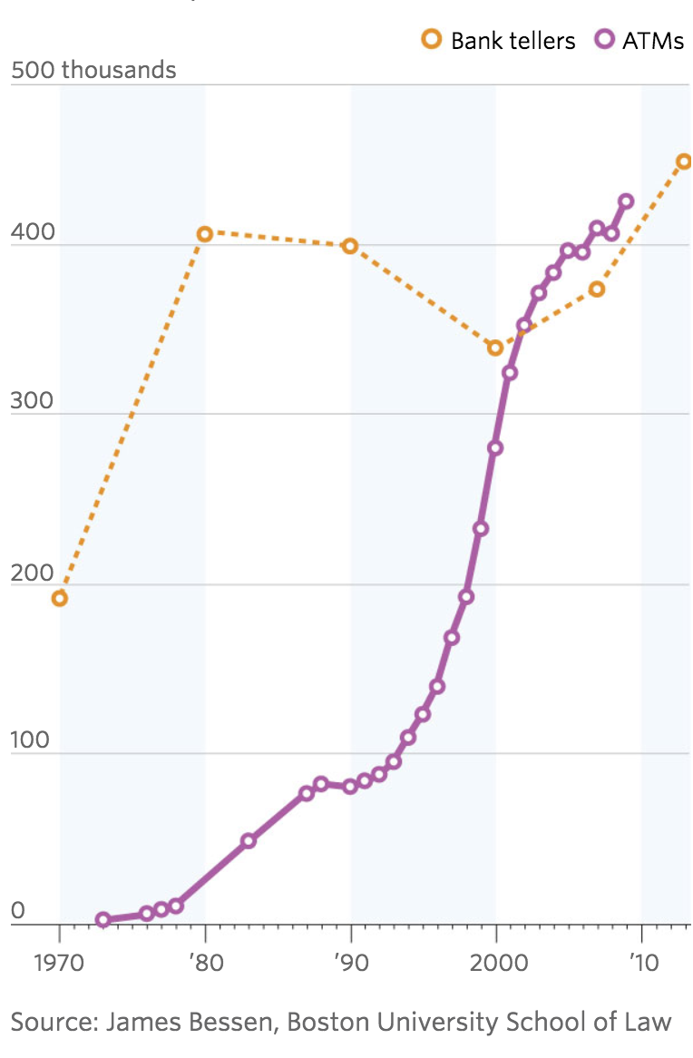
ATM Machines and Bank Teller Jobs

Slide 7
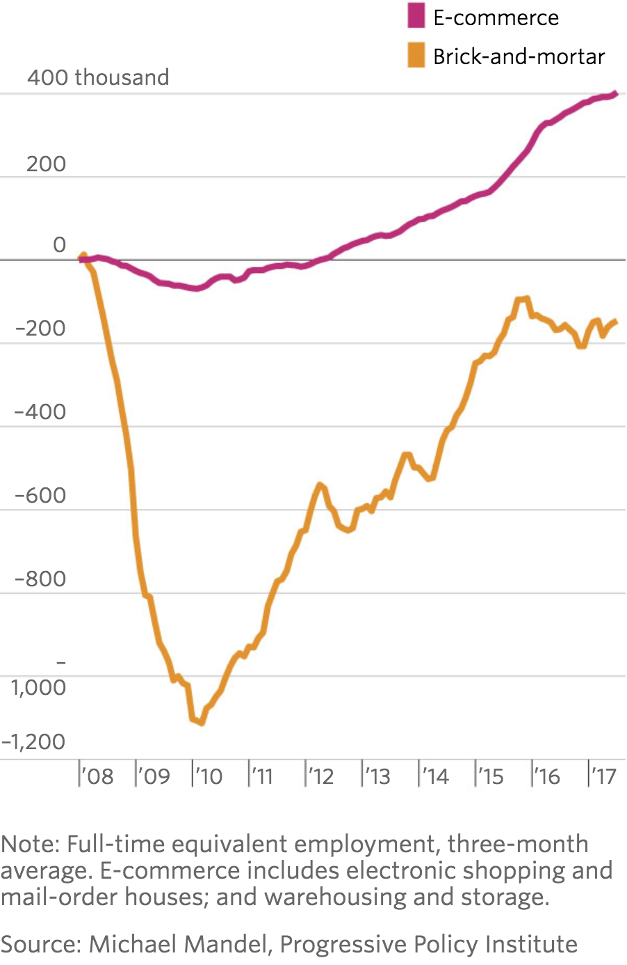
Brick and Mortar Retail Job Losses versus e-Commerce Job Gains

Slide 8
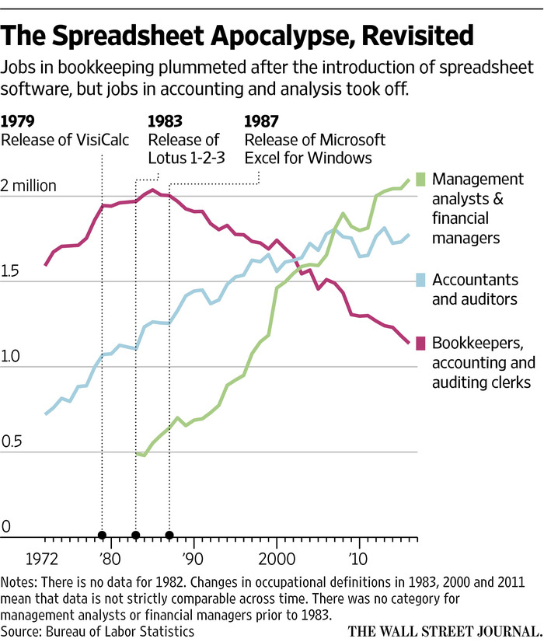

Slide 9
Conclusion
My horizon is the next 20 years, not 50 or 100 years
AI will displace some jobs, adding to labor market churn
Spreadsheet example pervasive – easy to predict jobs to be destroyed, harder to predict those to be created
AI is nothing new, and its evolution over the past decade has been accompanied by slow productivity growth and since 2009 by continuous net job creation, not net job destruction

