Slide 1
Slowing American Growth Despite Ongoing Innovation
Robert J. Gordon
Carroll School
Boston College, June 7, 2018

Slide 2
Why Growth in Output Matters, Not Just Productivity Growth
Output growth is divided by definition between growth in output per hour (productivity) and growth in hours of work
Output growth matters
To provide funds for education, infrastructure, old-age pensions, and medical care
To stimulate new investment
Growth in hours of work matters
To minimize the fiscal burden of an aging population

Slide 3
Preview
The US growth slowdown is caused both by productivity and labor input
It is universal across developed countries
The source of productivity change: the three industrial revolutions
How revolutionary is the current wave of innovations, especially robots and AI?
Special US problems – education, mortality, life expectancy, inequality

Slide 4
US Annual Percentage Growth Rate at a Constant Unemployment Rate, 1970-2006 vs. 2006-2016
Hours
Output per Hour
Output

Slide 5
GDP Growth at a Constant Unemployment Rate

Slide 6
Productivity Growth at a Constant Unemployment Rate

Slide 7
Hours Growth at a Constant Unemployment Rate

Slide 8
Sources of Slowdown: Those Shared with Other Developed Nations versus Special US Problems
Productivity Growth Slowdown
Shared by Western Europe, Developed East Asia
No mention here of catching-up process in emerging nations
Special US Problems
Education as a Source of Productivity Growth
Sources of Slower Growth in Hours
Fertility, Mortality, Immigration, Labor Force Participation

Slide 9
Productivity Growth, US vs. W. Europe (EU-15), 1955-2017

Slide 10
Productivity Growth, US vs. Dev. East Asia, 1955-2017

Slide 11
Slowing Productivity Growth Reflects a Smaller Impact of Innovation
The best organizing principle to think about innovation is to distinguish among the industrial revolutions (IR #1, IR #2, IR #3).
The 1st IR occurred 1770-1840, continued impact through 1900
Steam engine, railroad, steamships
Cotton spinning and weaving
Transition from wood to steel

Slide 12
Second Industrial Revolution: Six Dimensions of Growth
Electricity: Light, power, elevators, streetcars, subways, fixed and portable electric machines, kitchen appliances, air conditioning
Motor Vehicles: Cars and trucks replace horses, personal travel, commercial air transport
Info/Communication/Entertainment. Newspapers, telephone, phonograph, radio, motion pictures, TV
Chemicals. Plastics, antibiotics, modern medicine
Running water and sewers: Female liberation, conquest of infant mortality
Change in working conditions: from hot and dirty agriculture and industry to air-conditioned offices

Slide 13
All the Transitions That Could Only Happen Once
Mainly Rural 1870 => Mainly Urban 1950
Light: Polluting Flames to Instant On-Off
Power: From rubber belts to fixed and portable electric motors
Speed: “Hoof & Sail” => Boeing 707
Inside Temperature: From Cold and Hot =>> Central Heating and Air Conditioning
Instantaneous Communication: telegraph, telephone, radio, television
Bathrooms, running water, waste disposal
Life expectancy improved twice as fast 1900-1950 as 1950-2000

Slide 14
Third Industrial Revolution
Since 1960 the “EICT” Revolution
Entertainment: the evolution of TV from B&W to color to time-shifting and streaming
Information Tech – the evolution from mainframes to PCs, the web, and e-commerce
Communications: mobile phones, smart phones
Productivity enhancers: ATM, bar-code scanning, fast credit card authorization

Slide 15
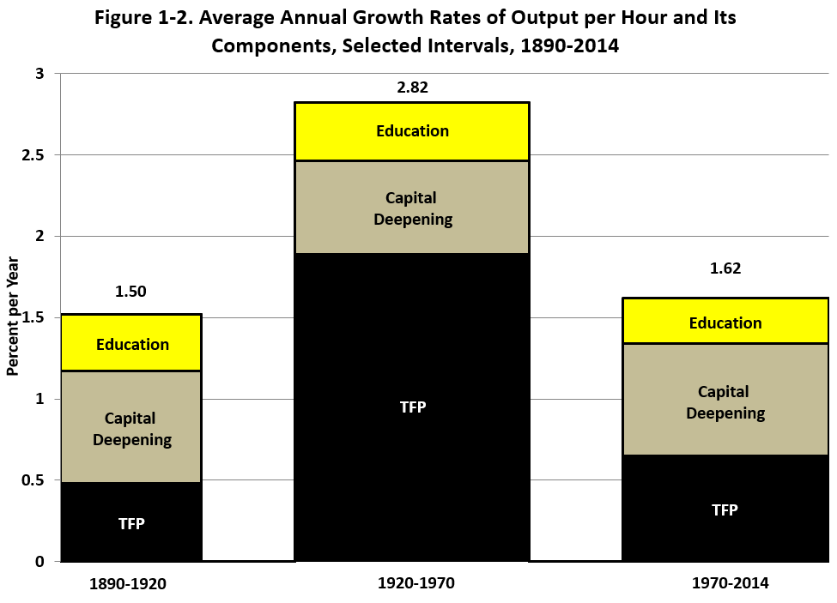
The Three Eras of Productivity Growth

Slide 16
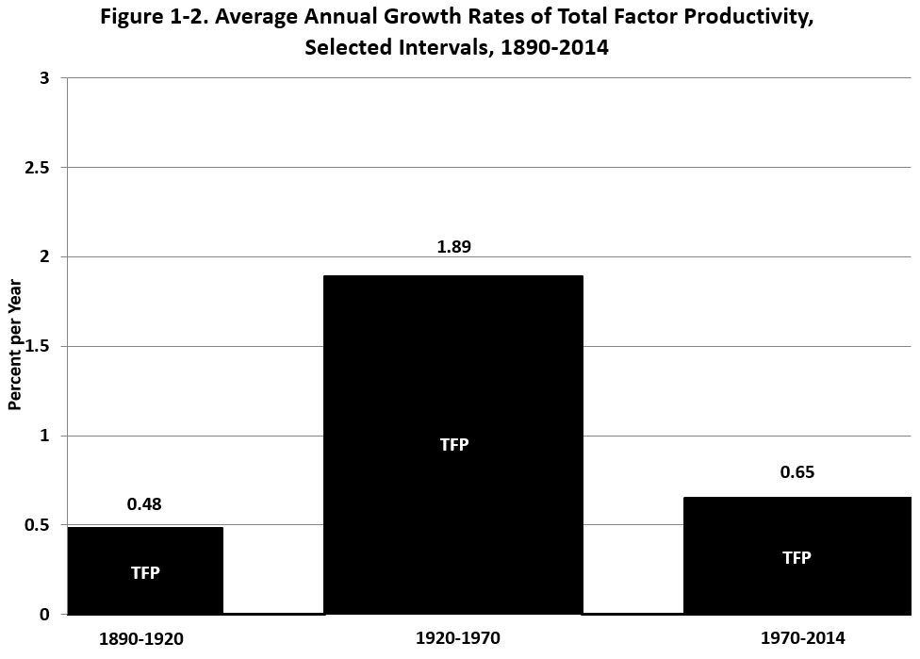
The Three Eras of TFP Growth

Slide 17
What Happened to Make Productivity Growth So Rapid before 1970?
The 2nd IR consisted of at least six dimensions of Great Inventions
Each invention had spinoffs developed over 1890-1970
In contrast the 3rd IR has been limited to one dimension, the EICT revolution
The 2nd IR altered every aspect of life for households and business, whereas the 3rd IR mainly mattered for business

Slide 18
TFP Growth 1952-2015, Five-Year Moving Average

Slide 19
IR #3 Has Failed the TFP Test
Failure #1: TFP growth post-1970 barely 1/3 of 1920-70
Failure #2: IR #3 boosted TFP growth only briefly 1996-2004
STARTLING QUESTON: HAS MOST OF THE PRODUCTIVITY IMPACT OF THE THIRD INDUSTRIAL REVOLUTION ALREADY HAPPENED?

Slide 20
IR #3 Changed Business Practices, Pre-Internet Phase 1, 1970-1995
1970 mechanical calculators, repetitive retyping, file cards, filing cabinets
1970s. Memory typewriters, electronic calculators
1980s. PCs with word processing and spreadsheets
Late 1980s, before the arrival of the internet.
E-mail, electronic catalogs, PCs connected inside firms, proprietary software

Slide 21
Completing the Change, 1995-2005
Late 1990s. The web, search engines, e-commerce
2000-05 flat screens, broadband in homes, airport check-in kiosks
By 2005 the revolution in business practices was almost over

Slide 22
Sources of Lack of Investment Opportunities
Offices use desktop and laptop computers much as they did 10-15 years ago
Stasis in Bricks & Mortar Retailing:
Shelves stocked by humans, meat sliced at service counters, bar-code checkout
E-commerce: humans packing and delivering boxes
Finance. ATMs, billion-share days
Medicine: electronic medical records are here, little change in what nurses and doctors do
Higher Education: rampant cost inflation

Slide 23
Innovations Continue But How Important Are They?
3-D Printing
Greatly speeded up speed and efficiency of designing prototypes, not mass production
Driverless Cars and Trucks
Recent crashes suggest fully autonomous vehicles not ready for prime time
Intracity truck drivers don’t just drive trucks, they unload them and stock the shelves
The large fleet of existing trucks won’t all be replaced at once

Slide 24
Innovations Continue But Are Evolutionary Not Revolutionary
Robots
Robots date back to 1961, by mid-1990s were welding and painting auto bodies
Robot description from NYT
Artificial Intelligence
Predominant uses of big data are in marketing, zero-sum game
Evolutionary change: legal searches, radiology reading, voice recognition, language translation
Artificial intelligence has already been replacing jobs for at least 20 years

Slide 25
AI: A Creator of Mass Unemployment?
No invention in 250 years since the First Industrial Revolution has created Mass Unemployment
16 million new jobs have been created since 2009
Enormous churn in labor market. March 6.3m job openings, 5.5m hires, 5.2m separations of which 3.2m were voluntary quits
Job losses from AI will be quickly offset by new jobs
Shortages of workers: skilled manufacturing, construction, even long-distance truck drivers

Slide 26
Key Flaw in Robots and AI: Can’t Match Human Dexterity
Lots of jobs have physical aspects that robots struggle with
Two robots were taught to assemble an IKEA chair but it took 3x as long as a human
Machines Excel at Abstract Cognitive Tasks Like Board Games
AI works by recognizing massive numbers of patterns, can’t reason exceptions
Autonomous vehicles have trouble coping with unusual situations

Slide 27
AI Job Displacement Is Nothing New
Airline and hotel reservations system replaced most travel agents
Voice recognition and language translation have replaced many transcribers and translators
Computer phone menus replaced some customer service agents
Most spending on AI is in marketing, but marketing analyst jobs have flourished
McKinsey Quarterly survey

Slide 28
ATM Machines and Bank Teller Jobs

Slide 29
Brick and Mortar Retail Job Losses versus e-Commerce Job Gains

Slide 30
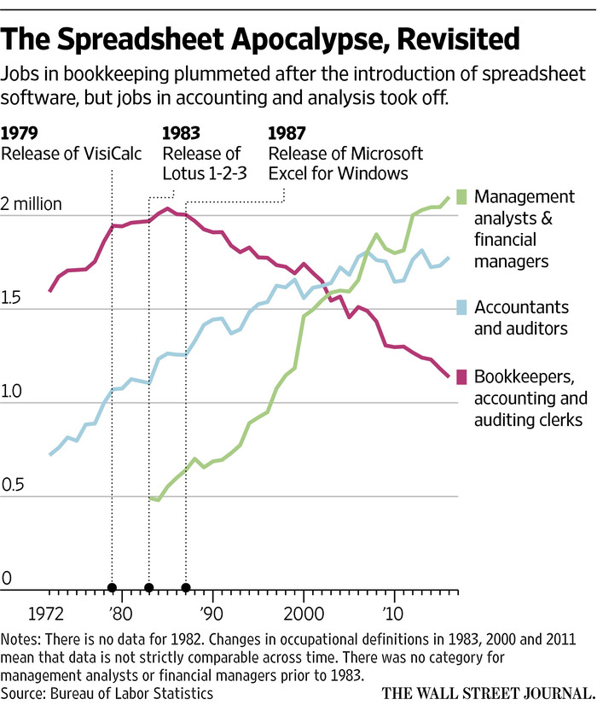

Slide 31
Conclusion About AI and Jobs
My horizon is the next 20 years, not 50 or 100 years
AI will displace some jobs, adding to labor market churn
Spreadsheet example pervasive – easy to predict jobs to be destroyed, harder to predict those to be created
AI is nothing new, and its evolution over the past decade has been accompanied by slow productivity growth and since 2009 by continuous net job creation, not net job destruction

Slide 32
Transition from Universal Issues to U.S.-Centric Problems
Sources of slower productivity growth are shared by all developed nations
US, Western Europe, Developed East Asia, Canada, Australasia
But some problems are unique to U.S.
Role of Education in Slowing Productivity Growth
Contribution of Labor Input to Slower Output Growth
Sources of Slower Population Growth
Sources of Fewer Hours per Person

Slide 33
Contributing to US Productivity Slowdown: Education
A major driver of that epochal 20th century productivity achievement was education
High school completion rate has barely changed since 1970.
Most people drop out of 2-year community colleges
College completion is increasing but 40% of recent graduates are in jobs that do not require a college education
High cost, growing indebtedness

Slide 34
The Education Plateau (Chart from 1940 to 2015)

Slide 35
College Completion: Lack of Progress for Men (Chart goes 1967-2015)

Slide 36
Education: International Comparisons
Poor preparation for college. International PISA test scores rank out of 34 OECD countries: US #17 in reading, 20th in science, 27th in math
U.S. has dropped from #1 to #16 in college completion as percent of population; same for high-school dropouts
This will reduce future economic growth by -0.3 percent per year compared to the contribution of education to 20th century growth

Slide 37
Hours Growth as a Source of Slower Output Growth
We have already seen that more than half of the slowdown in output growth from 1970-2006 to 2006-16 was caused by slower hours growth
Some of this was due to slower population growth
Lower Fertility, Higher Mortality, Lower Immigration
The remainder was caused by lower hours per person
Baby-boom retirement
Declining participation of adult men

Slide 38
US Fertility Rate Since 1960

Slide 39
Life Expectancy at Birth Since 1960

Slide 40
The US White Mortality Rate: The Contrast with Other Countries

Slide 41
Annual Rate of Change, Mortality Rate, 1999-2015

Slide 42
Legal and Illegal Immigration, Share of Population, 1960-2016

Slide 43
Total US Labor Force Participation Rate, 1950-2017

Slide 44
Participation Rate for Males Aged 25-54, 1950-2017

Slide 45
Inequality Implies that the Median Grows Slower than the Average
For 1993-2015 the top 1% earned 52 percent of the total income gain
Top 1% income growth 95%
Bottom 99% income growth 15%
This is continuing, it’s not over. Count the ways
CEO pay, sports and entertainment stars. ($10-15 million)
Wage pushbacks – lower wages, two-tier wages, shaving pension and medical care benefits
Firms pushing employees into part-time work, hiring “contract workers” instead of employees

Slide 46
The Income Share of the Top One Percent Since 1920

Slide 47
The Life Expectancy Gap by Income Quintile

Slide 48
Conclusion #1: Universal Causes of Slower Productivity Growth
Sources of slower output growth divided between slower growth in productivity and in hours of work
Sources of slower productivity growth shared in common by all developed countries
The third (digital) industrial revolution was less important than the second, compare U. S. growth 1920-70 with post-1970
Most of the impact of IR #3 on business methods and practices had already occurred by 2005
Robots have been around for 50 years, AI for 20 years – evolutionary rather than revolutionary change
Job destruction balanced by job creation

Slide 49
Conclusion #2: Special Issues Faced by U.S.
Contribution of education to economic growth is less than before 1970
Weak college completion of males, high cost
Slowing population growth contributes to slower output growth
Lower fertility, higher mortality, lower immigration
Lower hours per person contribute to slower output growth
Baby-boom retirement, lower participation of adult men
Big question for 2018-2019: How will demand-driven growth be supplied given shortages of labor.
Will productivity growth revive?

